Slide 1
Welcome!
Please use your computer speakers for audio.
<?xml version="1.0"?><AllQuestions />
<?xml version="1.0"?><AllResponses />
<?xml version="1.0"?><Settings><answerBulletFormat>Numeric</answerBulletFormat><answerNowAutoInsert>No</answerNowAutoInsert><answerNowStyle>Explosion</answerNowStyle><answerNowText>Answer Now</answerNowText><chartColors>Use PowerPoint Color Scheme</chartColors><chartType>Horizontal</chartType><correctAnswerIndicator>Checkmark</correctAnswerIndicator><countdownAutoInsert>No</countdownAutoInsert><countdownSeconds>10</countdownSeconds><countdownSound>TicToc.wav</countdownSound><countdownStyle>Box</countdownStyle><gridAutoInsert>No</gridAutoInsert><gridFillStyle>Answered</gridFillStyle><gridFillColor>255,255,0</gridFillColor><gridOpacity>50%</gridOpacity><gridTextStyle>Keypad #</gridTextStyle><inputSource>Response Devices</inputSource><multipleResponseDivisor># of Responses</multipleResponseDivisor><participantsLeaderBoard>5</participantsLeaderBoard><percentageDecimalPlaces>0</percentageDecimalPlaces><responseCounterAutoInsert>No</responseCounterAutoInsert><responseCounterStyle>Oval</responseCounterStyle><responseCounterDisplayValue># of Votes Received</responseCounterDisplayValue><insertObjectUsingColor>Red</insertObjectUsingColor><showResults>Yes</showResults><teamColors>Use PowerPoint Color Scheme</teamColors><teamIdentificationType>None</teamIdentificationType><teamScoringType>Voting pads only</teamScoringType><teamScoringDecimalPlaces>1</teamScoringDecimalPlaces><teamIdentificationItem></teamIdentificationItem><teamsLeaderBoard>5</teamsLeaderBoard><teamName1></teamName1><teamName2></teamName2><teamName3></teamName3><teamName4></teamName4><teamName5></teamName5><teamName6></teamName6><teamName7></teamName7><teamName8></teamName8><teamName9></teamName9><teamName10></teamName10><showControlBar>All Slides</showControlBar><defaultCorrectPointValue>0</defaultCorrectPointValue><defaultIncorrectPointValue>0</defaultIncorrectPointValue><chartColor1>187,224,227</chartColor1><chartColor2>51,51,153</chartColor2><chartColor3>0,153,153</chartColor3><chartColor4>153,204,0</chartColor4><chartColor5>128,128,128</chartColor5><chartColor6>0,0,0</chartColor6><chartColor7>0,102,204</chartColor7><chartColor8>204,204,255</chartColor8><chartColor9>255,0,0</chartColor9><chartColor10>255,255,0</chartColor10><teamColor1>187,224,227</teamColor1><teamColor2>51,51,153</teamColor2><teamColor3>0,153,153</teamColor3><teamColor4>153,204,0</teamColor4><teamColor5>128,128,128</teamColor5><teamColor6>0,0,0</teamColor6><teamColor7>0,102,204</teamColor7><teamColor8>204,204,255</teamColor8><teamColor9>255,0,0</teamColor9><teamColor10>255,255,0</teamColor10><displayAnswerImagesDuringVote>Yes</displayAnswerImagesDuringVote><displayAnswerImagesWithResponses>Yes</displayAnswerImagesWithResponses><displayAnswerTextDuringVote>Yes</displayAnswerTextDuringVote><displayAnswerTextWithResponses>Yes</displayAnswerTextWithResponses><questionSlideID></questionSlideID><controlBarState>Expanded</controlBarState><isGridColorKnownColor>True</isGridColorKnownColor><gridColorName>Yellow</gridColorName></Settings>
<?xml version="1.0"?><AllAnswers />

Slide 2
Sharing Session
Specialized Processes-Fermentation and Curing
April 9, 2019
<?xml version="1.0"?><AllQuestions />
<?xml version="1.0"?><AllResponses />
<?xml version="1.0"?><Settings><answerBulletFormat>Numeric</answerBulletFormat><answerNowAutoInsert>No</answerNowAutoInsert><answerNowStyle>Explosion</answerNowStyle><answerNowText>Answer Now</answerNowText><chartColors>Use PowerPoint Color Scheme</chartColors><chartType>Horizontal</chartType><correctAnswerIndicator>Checkmark</correctAnswerIndicator><countdownAutoInsert>No</countdownAutoInsert><countdownSeconds>10</countdownSeconds><countdownSound>TicToc.wav</countdownSound><countdownStyle>Box</countdownStyle><gridAutoInsert>No</gridAutoInsert><gridFillStyle>Answered</gridFillStyle><gridFillColor>255,255,0</gridFillColor><gridOpacity>50%</gridOpacity><gridTextStyle>Keypad #</gridTextStyle><inputSource>Response Devices</inputSource><multipleResponseDivisor># of Responses</multipleResponseDivisor><participantsLeaderBoard>5</participantsLeaderBoard><percentageDecimalPlaces>0</percentageDecimalPlaces><responseCounterAutoInsert>No</responseCounterAutoInsert><responseCounterStyle>Oval</responseCounterStyle><responseCounterDisplayValue># of Votes Received</responseCounterDisplayValue><insertObjectUsingColor>Red</insertObjectUsingColor><showResults>Yes</showResults><teamColors>Use PowerPoint Color Scheme</teamColors><teamIdentificationType>None</teamIdentificationType><teamScoringType>Voting pads only</teamScoringType><teamScoringDecimalPlaces>1</teamScoringDecimalPlaces><teamIdentificationItem></teamIdentificationItem><teamsLeaderBoard>5</teamsLeaderBoard><teamName1></teamName1><teamName2></teamName2><teamName3></teamName3><teamName4></teamName4><teamName5></teamName5><teamName6></teamName6><teamName7></teamName7><teamName8></teamName8><teamName9></teamName9><teamName10></teamName10><showControlBar>All Slides</showControlBar><defaultCorrectPointValue>0</defaultCorrectPointValue><defaultIncorrectPointValue>0</defaultIncorrectPointValue><chartColor1>187,224,227</chartColor1><chartColor2>51,51,153</chartColor2><chartColor3>0,153,153</chartColor3><chartColor4>153,204,0</chartColor4><chartColor5>128,128,128</chartColor5><chartColor6>0,0,0</chartColor6><chartColor7>0,102,204</chartColor7><chartColor8>204,204,255</chartColor8><chartColor9>255,0,0</chartColor9><chartColor10>255,255,0</chartColor10><teamColor1>187,224,227</teamColor1><teamColor2>51,51,153</teamColor2><teamColor3>0,153,153</teamColor3><teamColor4>153,204,0</teamColor4><teamColor5>128,128,128</teamColor5><teamColor6>0,0,0</teamColor6><teamColor7>0,102,204</teamColor7><teamColor8>204,204,255</teamColor8><teamColor9>255,0,0</teamColor9><teamColor10>255,255,0</teamColor10><displayAnswerImagesDuringVote>Yes</displayAnswerImagesDuringVote><displayAnswerImagesWithResponses>Yes</displayAnswerImagesWithResponses><displayAnswerTextDuringVote>Yes</displayAnswerTextDuringVote><displayAnswerTextWithResponses>Yes</displayAnswerTextWithResponses><questionSlideID></questionSlideID><controlBarState>Expanded</controlBarState><isGridColorKnownColor>True</isGridColorKnownColor><gridColorName>Yellow</gridColorName></Settings>
<?xml version="1.0"?><AllAnswers />

Slide 3
Overview
Boulder County Curing &
Fermenting Review Process
Fermentation Food Safety
Q&A Session

Slide 4
Housekeeping Items
Throughout the presentation and during the discussion and Q&A session, please use the chat box to share your experiences and questions. The facilitator will pose your questions to the presenters.

Slide 5
Housekeeping Items
A link to the recorded webinar will be emailed to all participants. This recording and past food safety sharing sessions can also be found the NACCHO website:
http://www.naccho.org/programs/environmental-health/hazards/food-safety/

Slide 6

Zack Lustgarten

Slide 7

Curing and Fermenting Review Process
Zack Lustgarten, REHS, CP-FS, MS
Notes:
Zack Lustgarten is a Registered Environmental Health Specialist and Certified Food Protection Specialist with Boulder County Public Health located in Colorado. Zack has an undergraduate degree in Environmental Health Science from Ohio University. He also holds a masters in Environmental Policy and Planning from Ohio University. He has worked in a variety of Environmental Health roles at the federal, state, and local levels during his 10 plus year career that has taken him from Arizona to Ohio to Colorado. Zack has been with BCPH a little over 3 years and currently oversees the standardization and training of inspection staff, reviews HACCP plans, and conducts regulatory inspections of retail food establishments in Boulder County.

Slide 8
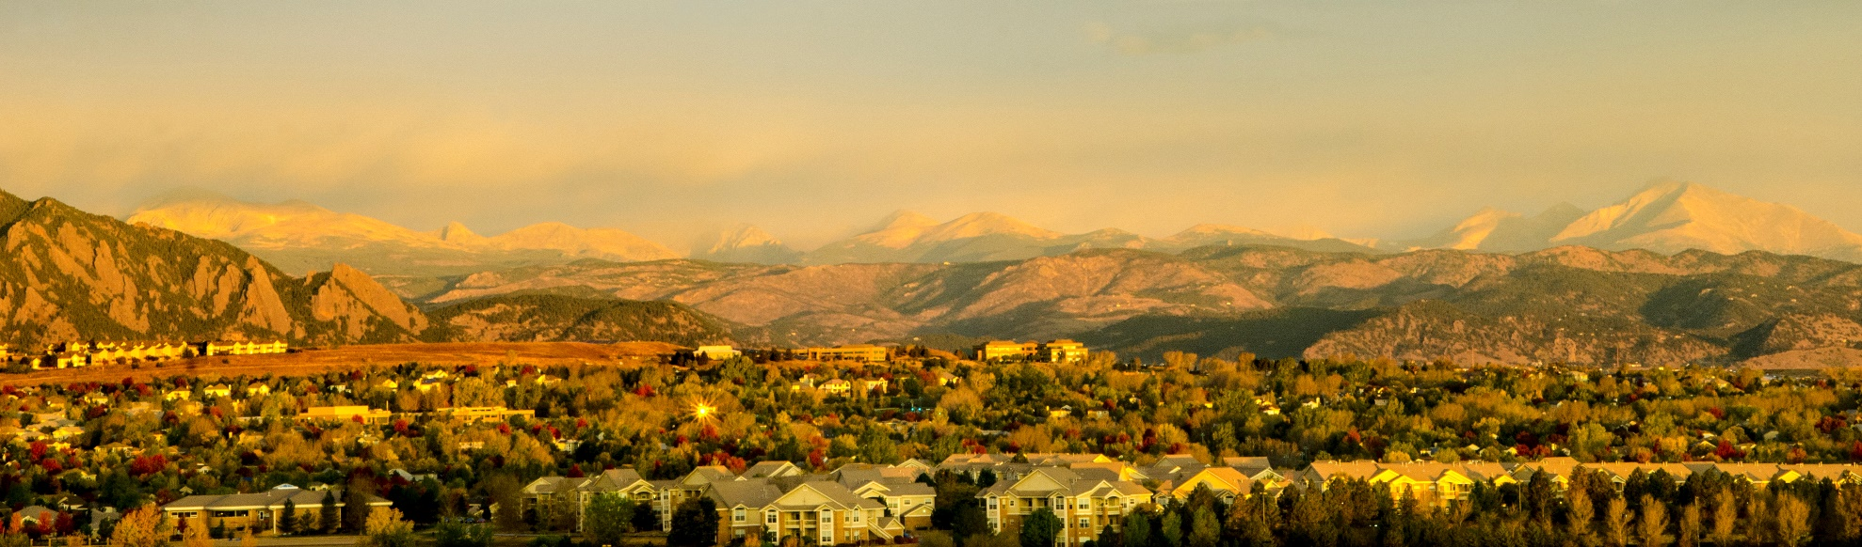
Boulder County, Colorado
Notes:
I want to thank you for the opportunity to share how our department reviews HACCP plans and how we handle Curing and Fermenting.
But first….
I wanted to start by giving a background of Boulder County.
Boulder County spans 742 square miles located in north central Colorado,
Eastern Boulder County begins in the High Plains, at just under 5,000 feet above sea level, and climbs through the foothills, montane, sub-alpine and alpine ecosystems to Longs Peak at 14,259 feet.
The estimated population of Boulder County for 2017 is just over 323,000.

Slide 9

Cities Served
*Includes towns of Erie, Jamestown, Lyons, Nederland, Superior and Ward, and unincorporated areas such as the communities of Allenspark, Eldorado Springs, Gunbarrel and Niwot.
Notes:
The estimated population of Boulder County for 2017 is just over 323,000.

Slide 10

Food Safety Program
Vision
The BCPH Food Safety Program vision is a community free of foodborne illness that is responsible, informed, and partners with our Food Safety Program, a trusted and innovative leader.
Mission
The program mission and goal is to protect, promote, and enhance the health and well-being of the community by preventing foodborne illness.
Notes:
The Food Safety program is housed under the Environmental Health Division of Boulder County Public Health (BCPH)
The BCPH Food Safety Program vision is a community free of foodborne illness that is responsible, informed, and partners with our Food Safety Program, a trusted and innovative leader.
The program mission and goal is to protect, promote, and enhance the health and well-being of the community by preventing foodborne illness.

Slide 11
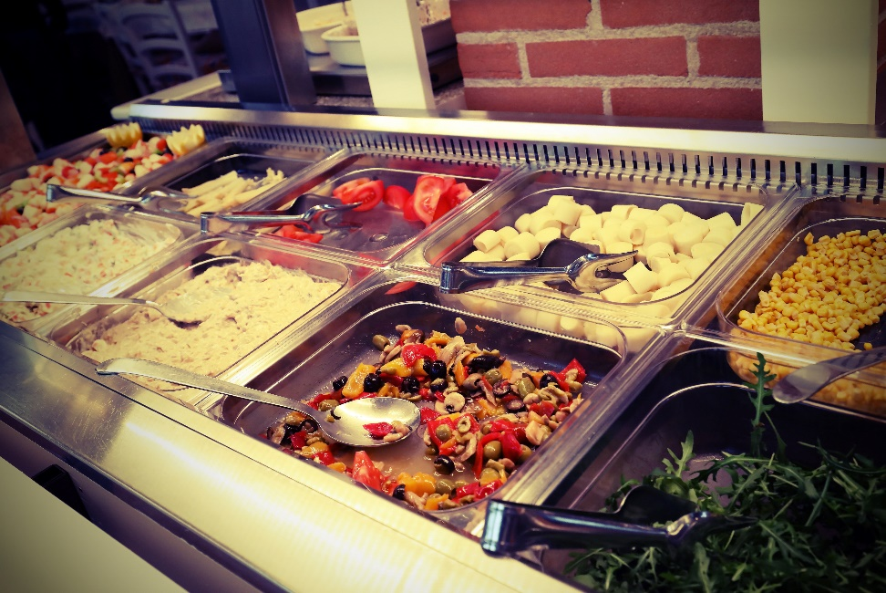
Food Safety Program
Plan Reviews
Inspections
Complaints and FBI investigations
HACCP reviews
Notes:
The Food Safety program is responsible for licensing and inspecting all brick and mortar retail food establishments, mobile units, special events, and temporary events
In addition to routine inspections, we respond to complaints, FBIs, conduct plan reviews of new establishments and change of ownerships, and finally, we review and approve HACCP plans.
Program staffing is comprised of 8.0 full-time equivalent (FTE) employees to do field work (7 full-time field staff and 3 part-time field staff), 1 team leader, and 1 program coordinator to work with nearly 1,700 retail food establishments.

Slide 12

Specialized Processing
2013 FDA Food Code
Adopted January 1st, 2019
  HACCP with Variance now required for specialized processing methods
Notes:
One of my core responsibilities is to conduct all HACCP reviews for specialized processing methods.
An item of note is that Colorado adopted by reference the 2013 FDA food Code on January 1st of this year. This has changed our process a bit. In the past, we required a recognized third party process authority to review and approve the HACCP plan prior to submittal to the LPHA, but with the adoption of the food code that is no longer a requirement. ROP HACCPs were the only exception to this rule.
Now the state is required to review all HACCP plans that require a variance and make a final ruling. This would include curing and fermentation processing.

Slide 13
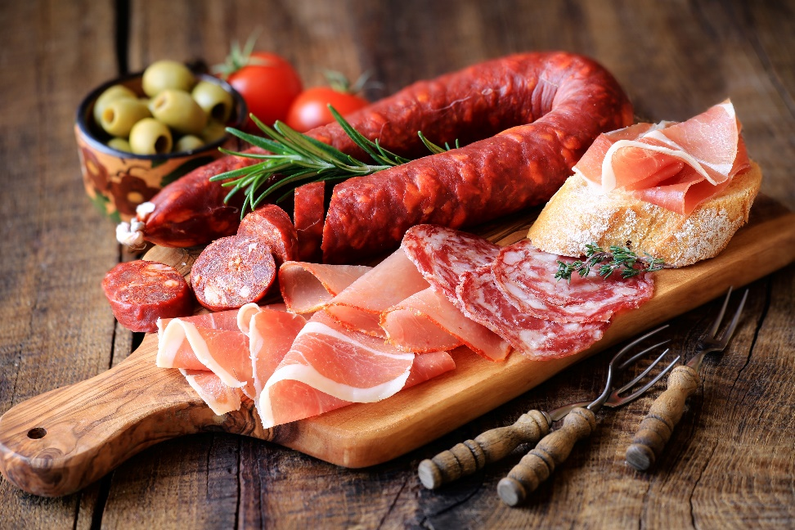
Steps to Conduct Review
Pre-submittal Consultation
Application Submission And Validation
Letter To State For Final Approval Review
On-site Verification

Slide 14

Pre-Submittal Consultation
Notes:
Unfortunately, pre-submittal consultation is often a result of field inspections where a process is discovered. In this instance, the product is discarded or embargoed and the process may not be resumed until a HACCP plan with Variance approved from the LPHA and state is in place.
Pre-submittal consultations are a great time for the reviewer to go over all the essential items that must be included in a HACCP plan submittal. This is commonly done during an on-call day, which is a designated day that staff are in the office to address walk-ins.

Slide 15
Commonly Encountered Foods
Fermenting
    Lactic Acid:
      Kimchi, Yogurt,, Crème Fraiche, Sauerkraut
    Alcohol:
      Kombucha, Kefir
Curing
    Bacon
Combination of Curing And Fermenting
    Charcuterie Such As Sausages And Salamis

Slide 16


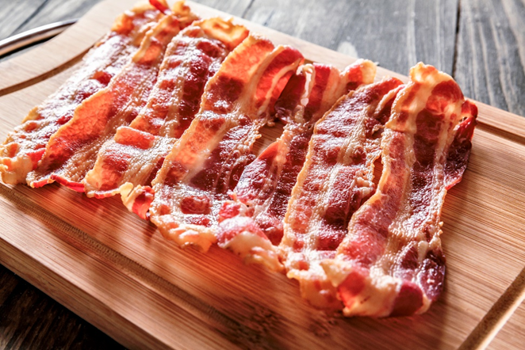
Commonly Encountered Foods

Slide 17

Colorado-Specific Consideration
Statewide Variance for Fermenting
  Standard Recipe
  Lab tested final pH >4.2
  ≤41°F
  Date marked 7 days
Notes:
Prior to the adoption of the FDA food code, if the following processes were in place and documented a facility could avoid HACCP for commonly fermented products: We have yet to come across a fermentation HACCP to date since the adoption of the food code, but a state-wide variance with these is expected to allow for these processes to be conducted without a HACCP plan
1. A standardized recipe is used. A “standardized recipe” means that the batch size, ingredient list, amounts of each ingredient, and the mixing/fermentation time remain the same for each batch.
2. pH monitoring (lab or batch tested) verifying the pH is below 4.2,
3. product is maintained at 41°F or below following the fermentation process, and
4. product is date marked and disposed of 7 days after being placed in cold holding.

Slide 18
HACCP Application and Validation
Notes:
This is a list of the required documents that must be included in the HACCP plan when submitted to the food safety program.
The HACCP plan itself should identify hazards of each processing step.

Slide 19
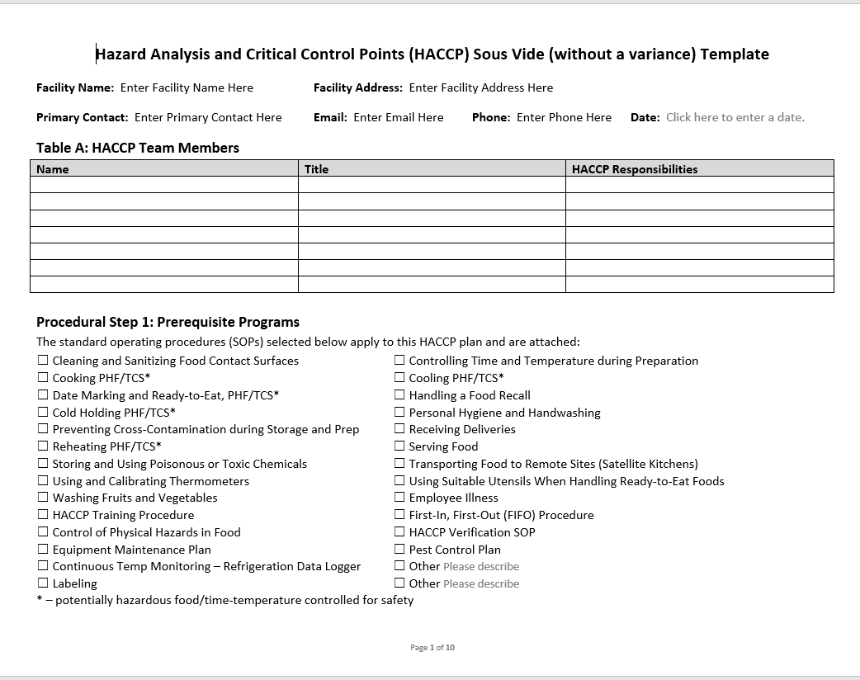
Validation
Notes:
One of the hardest things for operators to understand is just what to include in a HACCP plan. As you can see from the previous slide, there is a lot of required documentation. In Boulder County, we have created HACCP templates for ROP to assist the operator in submitting a full plan. Although we don’t have templates for curing or fermenting, we still use these templates as resources for the operator to ensure they are getting all the elements in the submitted plan.

Slide 20
Validation Elements Required (cont’d)
Introduction
Flow Chart
Hazard Analysis
HACCP Plan
SOP’s
Training Program
Records
Notes:
Introduction:
Product Description
A list of the ingredients and a recipe name for the product(s)
A list of the equipment used and description of designated area where process will occur.
Example Scale to measure sodium nitrite
Flow Chart:
A chart that documents the flow of the food product through your facility from Receiving to Serving to the customer, identifying the steps that are Critical Control Points
Hazard Analysis:
A chart that documents the operational steps food will good through in your facility,
The potential hazards; biological, chemical, physical
Answering whether the hazards are significant in your facility
Justification for that answer
Listing the control measures that can be applied to prevent the significant hazards
Answering whether this step will be considered a Critical Control Point
HACCP Plan:
A chart documenting each critical control point, the hazards, the critical limits, the monitoring
procedures, the corrective actions, verification, and the records used.
SOPs:
No Bare Hand Contact with Ready to Eat foods
Designated and segregated work area
Cleaning and sanitizing areas
handwashing protocols
how cross contamination between raw and ready-to-eat foods will be prevented and where the processing will occur.
Labeling Practices
PH Calibration
Training Program:
written program that outlines the training food employees and managers receive in order to perform the special processing tasks.
A chart documenting the employee name, the training received, the date and time of the training, and initialed by the employee and trainer.
Records: Using cured/fermented sausages as an example
Thermometer Calibration,
Refrigeration/Freezer Daily Temperatures
Receiving Charts
Curing logs
pH fermentation log
Final Cook/Cool Time/Temperatures log,
Drying log
Deviation log

Slide 21
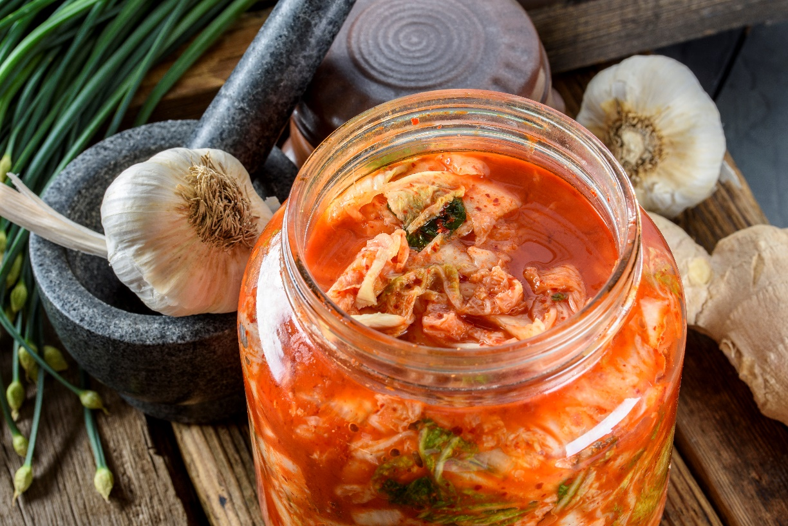
Common Deficiencies
Notes:
Common deficiencies seen in the submitted materials are varied, but often are found within the actual HACCP plan itself. Here is a small list of common deficiencies that we see:
Misidentification of Critical Control Points:
¨ A CL must be provided for each CCP
¨ Is the CL correct based on Food Code?
¨ Can the CL be measured? How?
¨ Will this CL control the hazard(s)?
Lack of supporting SOPs including corrective actions
¨ Have a specific corrective action(s) for each CCP that is out of compliance
¨ Who will be responsible for the corrective action?
¨ How will each occurrence be documented?
¨ Plan for food disposal when necessary (SOP)
¨ Does the established monitoring plan identify all deviations?
Lab testing
Specific areas of Concern with Curing
Lab anayslis:
Typically Max limit is of curing salt (nitrate, nitrite) 200ppm in cured meat and poultry. Nitrite poisoning can occur from improper handling and inaccurate weighing. 9 CFR424.21 spells out the allowable limit
For bacon, The USDA requires both a minimum and maximum level of curing salts (either sodium nitrite or sodium nitrate) be used. Bacon has a special maximum limit of 120 ppm nitrite to minimize nitrosamine formation during later cooking.
If they intend to mix cure in house I get concerned so we want to make sure they have a clear plan in place to address the mixing. A better solution is a Cure mix be bought pre-measured and packaged for use with a specific weight of meat to avoid errors in mixing since nitrite is a toxic chemical
Fermenting:
Source of the Culture: should be from a licensed and inspected source
Recipe is where I get concerned. I want a standard recipe and pH test results.
Need to start with a pasteurized milk product; Raw unpasteurized milk is not acceptable.
Commercial starter Culture
Final pH achieving 4.6 or lower and what are corrective actions
Curing and Fermenting:
The following CCPs are designed to control the above hazards.
CCP1 – Curing salts addition inhibits sporeforming pathogen growth: The USDA requires both a minimum and maximum level of curing salts (either sodium nitrite or sodium nitrate) be used.
CCP2 – a fermentation pH of 5.3 or less prevents growth and toxin production by S. aureus. The industry calls this “degree-hours”.
CCP3 – A thermal process eliminates any vegetative pathogens that might be present. Typically a low cook temperature is used for one to several hours to affect pathogen lethality.
CCP4 – If an operator desires the sausage be shelf stable, then the product must also be dried to a suitable water activity (≤ 0.90). Doing so prevents the outgrowth of any pathogens that might have been acquired post thermal processing. The alternative is simply to refrigerate the sausage. L. monocytogenes (the psychrotroph) cannot grow at ≤ 41F at any pH ≤ 5.
Keeping up with the required records
Unlabeled product

Slide 22

Position Letter
Notes:
Once reviewed, a position letter is prepared for the state for final approval of any specialized processing methods that require Variances.

Slide 23
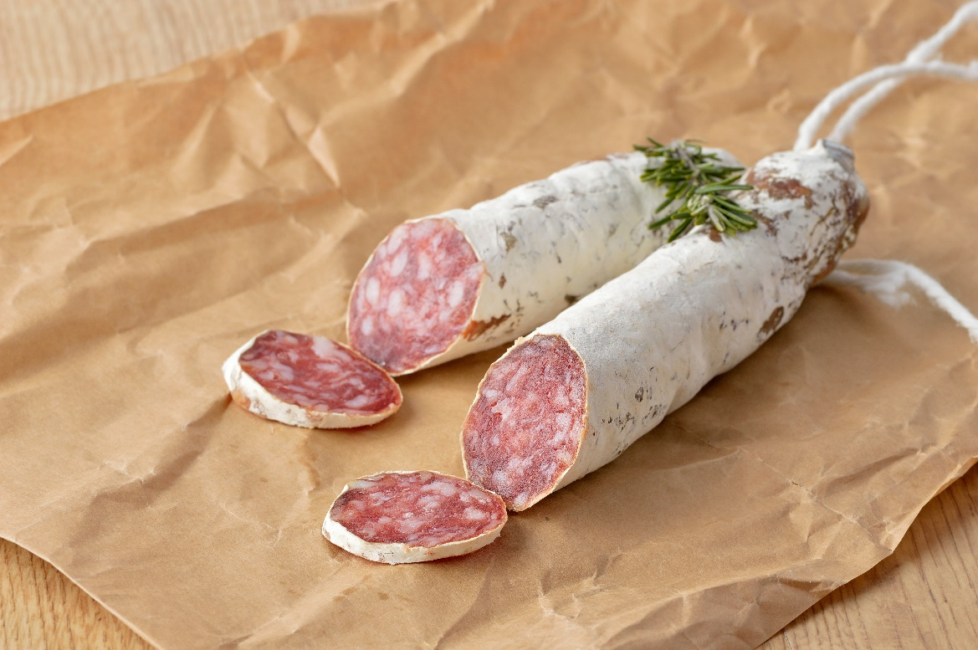
Onsite Verification
Notes:
Using cured and fermented sausages as an example I would check
1.HACCP plan is present
2. Establishment has Implemented Effective SOP and SSOP Prerequisites
Temperature, time and humidity meets Lethality Standards based on the product, or another approved validated process is available
Proper time/temperature controls implemented, including degree hours, during fermentation
Proper water activity and pH controls implemented
Commercial starter culture used for fermentation
Proper drying and humidity temperature implemented
3. Monitoring Records Are Present
Food flow and formulation are consistent with flow chart and approved HACCP plan
Critical control points and critical limits are followed per HACCP Plan
Employee demonstrates calibration and CCP measurement for inspector
Employee uses forms for recording formulation, calibration, and other measurement during inspection
Individual(s) responsible for maintaining system and verification that required records are being completed and properly maintained is identified by establishment
Records for the present day are accurate for the observed situation in the facility
Employee demonstrates knowledge of CCPs and critical limit for their retail process when asked
Employee demonstrates understanding of importance of critical limit(s) when asked
Routine calibrations are performed and documented on the appropriate form according to the plan
Monitoring actions performed according to the HACCP plan
Are there specific strengths or weaknesses with the current monitoring or record keeping regimen?
Shelf-stable fermented sausage meets required water activity or MPR requirements
Review Logs
Review HACCP plan
Finally, Has anything changed since approval?

Slide 24

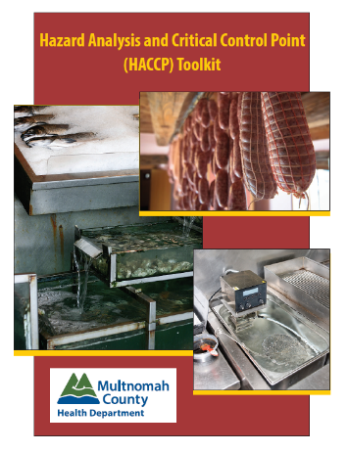
Resources
AFDO HACCP Guide
FDA Regulator’s Manual
for HACCP
BCPH Guides and Templates
NEHA Courses https://nehahaccp.org/RetailHACCP.php
Dr. Nummer www.food-safety.guru
Multnomah County Toolkit https://multco.us/file/39943/download
Notes:
My last piece of advice is that every HACCP plan that comes across your desk that relates to these subjects is different. I utilize my resources early and often.

Slide 25

Thank You
Zack Lustgarten, MS, REHS, CP-FS
Phone: 303.441.1159
Email: zlustgarten@bouldercounty.org

Slide 26

Dr. Brian Nummer

Slide 27
FERMENTATION FOOD SAFETY
“From Rot to Religion”
GMPs | GFPs | HACCP

Slide 28
Fermented foods (the good)
probiotics
Vitamin and nutrient byproducts
Safe “spoilage”
Intestinal fortitude
Leaky gut concept, biota byproduct concept, antimicrobial concept,
fecal transfers (yum), antioxidant concept, more

Slide 29


A “culture” gap
“I know that’s how its done, but I am going to do it
my way”
“It’s too acidic, I am changing the recipe”
“Of course the probiotics are alive,
why wouldn’t they be?”
“I get my culture from my neighbor”
“My ____ cures everything!”
“I am an expert. Foods have spoiled in my restaurant
for 20 years”
Foodborne illnesses
Cb, Ec, SA, SAL, Lm

Slide 30


A “culture” gap
Food Freedom
KIMCHI
Guaranteed safe by our legislators
I didn’t let the dogs and cats in the kitchen when I made it
All of my relatives tell me
“it’s the best”
pH?, stands for
perfectly harmless

Slide 31
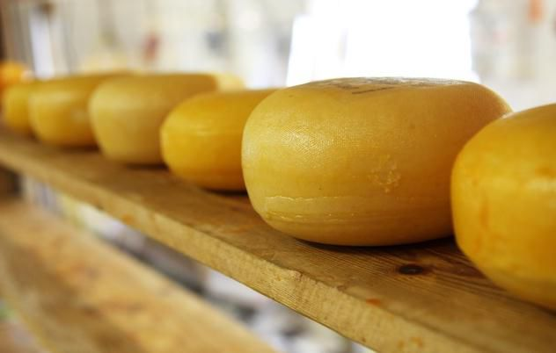
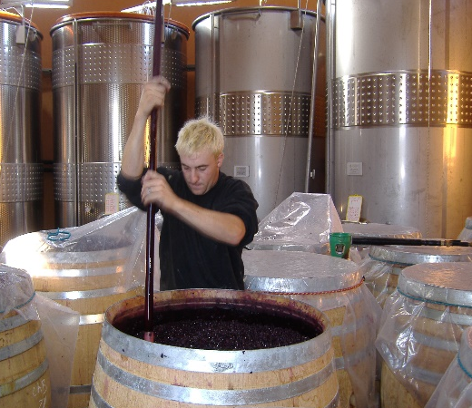
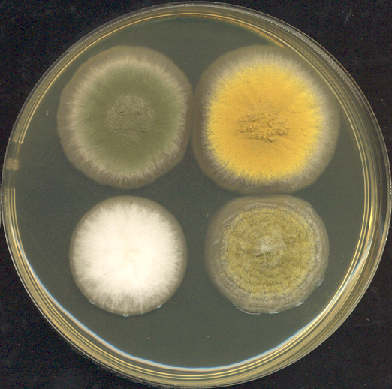
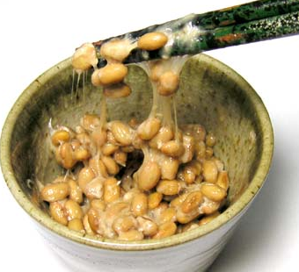
FERMENTATIONS
Lactic Acid
Lactic Acid (+)
Alcohol
Alcohol to acetic acid
Mold
involved
Others
Nut cheese
Sauerkraut
(kimchi), meats
Kombucha
(kefir)
(vinegar)
Sake, Tempeh
Blue Cheese
Natto
Fish sauces

Slide 32
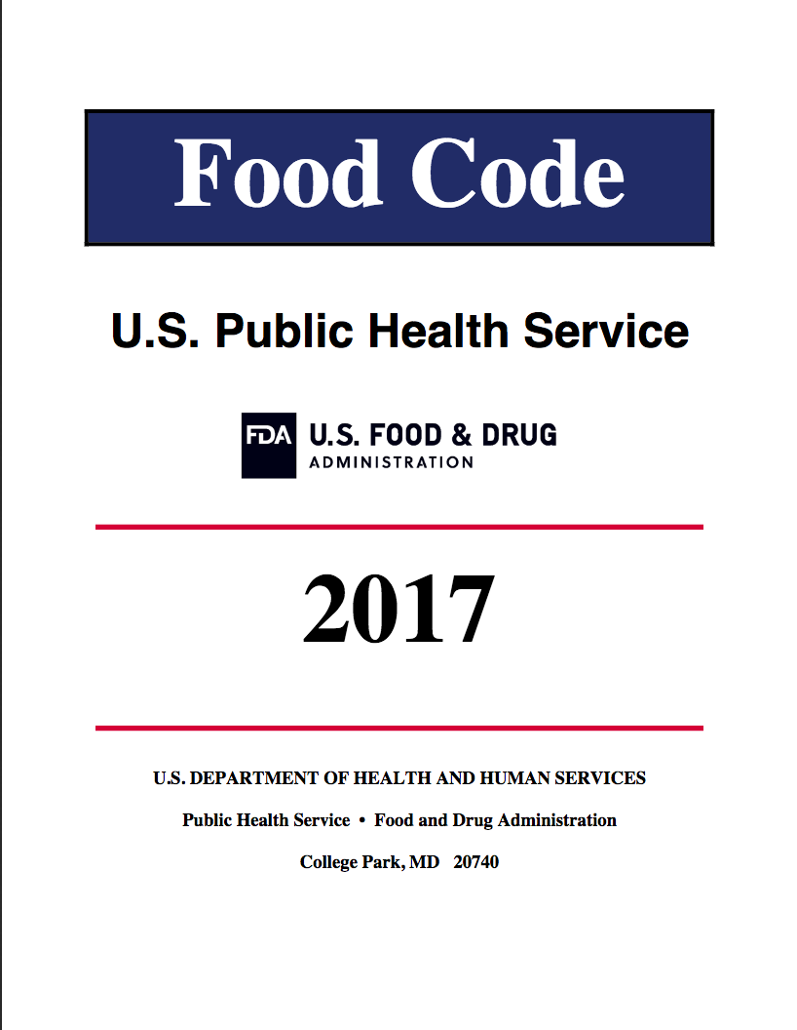
FERMENTATION IN RETAIL-FOODSERVICE
Fermentation is a “Special Process”
All special processes require HACCP
GMP = Good manufacturing practices are guidelines for manufacturers
The US FDA model Food Code prescribes the required GMPs for retail-foodservice operators
The food code is prescriptive, while GMPs are flexible.
Notes:
Before we get started, there are a few abbreviations that assist the viewer in this course. GMP naturally stands for good manufacturing practices. PC is for Preventative controls. Those are new required controls discussed in FSMA or the Food Safety Modernization Act. The FD&C act is the food drug, and cosmetic act. CFR is for Code of Federal Regulations. PIC is person in charge. The word “manufacture” in this course means “manufacture, process, pack, or hold food for human or animal consumption. The exclamation point graphic represents the term to “minimize or prevent cross contamination or cross contact”. That term occurs so frequently in the GMPs it is easier on understanding to abbreviate it.

Slide 33
GOOD PRACTICES
MANUFACTURING
FERMENTATION
HACCP
Preliminaries

Slide 34
HACCP Preliminaries
5 Steps to get started after GMP/GFPs are met
01
Create a HACCP team
04
Create/verify a flow diagram
02
Describe the fermented food product and consumer
05
Consult Regulatory Agency
03
List ingredients, packaging, and equipment

Slide 35
DAIRY
Yogurt
Cultured milk and butter
Kefir (dairy)
Cheese
Acidophilus milk

Slide 36
Ingredients: 1-gal milk (cream, whole, low fat, or skim)—In general the higher the milk fat level in the yogurt the creamier and smother it will taste. High fat yogurt will not "set".
Nonfat dry milk powder—Use 1 and 1/3-cups when using whole or low fat milk, or use 2 and 2/3-cups powder when using skim milk. The higher the milk solids the firmer the yogurt will be.
Commercial, unflavored, cultured yogurt—Use 1-2 cups. Be sure the product label indicates that it contains a live culture. Also note the content of the culture. L. bulgaricus and S. thermophilus are required in yogurt, but some manufacturers may in addition add L. acidophilus and/or B. bifidum. The latter two are used for health reasons attributed to these organisms.
(Optional) 2 to 4 tablespoons sugar or honey. (Optional) For a thick, firm yogurt swell 1 teaspoon unflavored gelatin in a little milk for 5 minutes. Add this to the milk mixture before cooking.
Process: Combine ingredients except culture and heat. Heating the milk is a necessary step to change the milk proteins so that they set together rather than to form curds and whey. This heating step will also serve as pasteurization. Place cold, pasteurized milk in top of a double boiler and stir in nonfat dry milk powder. Adding non-fat dry milk to heated milk will cause some milk proteins to coagulate and form strings. Add sugar or honey if a sweeter, less tart yogurt is desired. Heat everything to 200°F, stirring gently and (a) hold for 10 minutes for thinner yogurt or (b) hold 20 minutes for thicker yogurt. Do not boil. Be careful and stir constantly to avoid scorching if not using a double boiler.
Cool milk rapidly to 112-115°F. Remove one cup of the warm milk and blend it with the yogurt starter culture. Add this to the rest of the warm milk. The temperature of the mixture should now be 108-112°F.
Incubate. Pour immediately into clean and sanitary container(s); cover and place in prepared incubator. Close the incubator and incubate about 4-8 hours at 110°F +/-5°F. Yogurt should set firm when the proper acid level is achieved (~pH 4.6). Incubating yogurt for several hours past the time after the yogurt has set will produce more acidity. This will result in a more tart or acidic flavor and eventually cause the whey to separate. Pour off the whey to obtain "greek style" yogurt.
Refrigerate. Rapid cooling stops the development of acid. Yogurt will keep for about 10-21 days if held in the refrigerator at 41°F or lower.
YOGURT
Rec
Prep
Cook
Cool
Ferm
Refr
Stor
Sell
≤ 41ºF
108ºF ≤ 8h
200ºF

Slide 37
FRUITS
Vinegars
Kombucha (tea)
Water (fruit) kefir
Alcoholic
shrubs

Slide 38
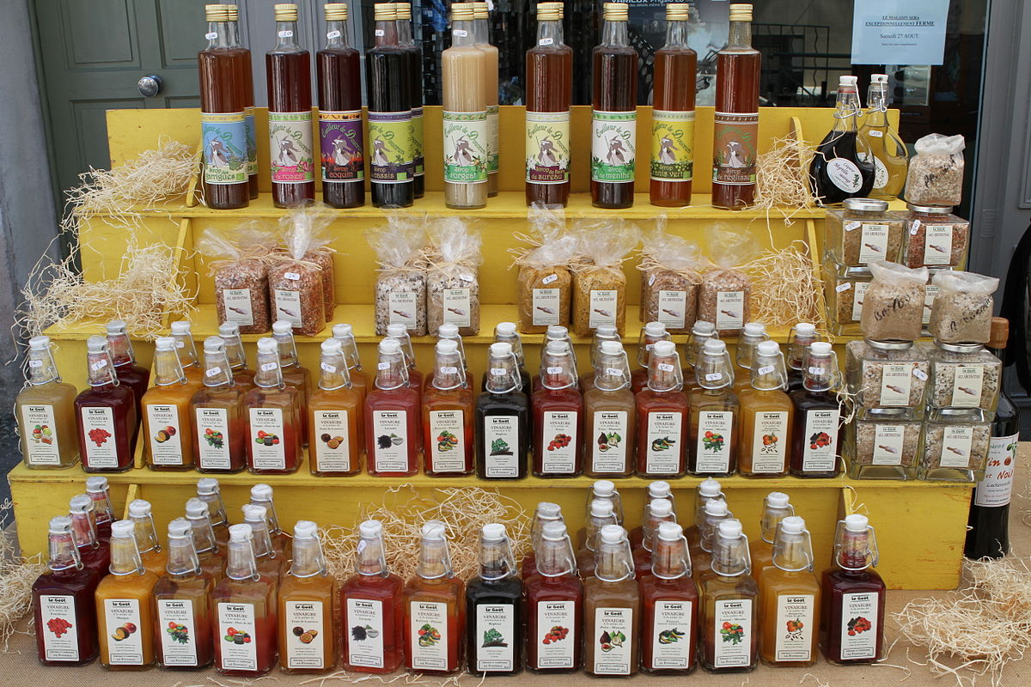
Notes:
Photo CC https://upload.wikimedia.org/wikipedia/commons/thumb/c/c3/Eguilles_20110828_14.jpg/1200px-Eguilles_20110828_14.jpg

Slide 39
Vinegars
Ingredients:
Fruit or a starch/sugar source (starches have to be converted to sugars), water, (optional fruit juice and sugar for shrubs)
Yeast culture (anaerobic alcohol fermentation)
Acetic acid culture (aerobic oxidation)
Process:
All ingredients are received and stored as needed. Prep will include preparing the sugar source for fermentation. Sometimes the sugar syrup is pasteurized to remove competitive microbes.
A standard yeast (Saccharomyces cerevisiae) fermentation is allowed to work producing alcohol and CO2 from the sugars.
A secondary aerobic oxidation (fermentation) with Acetobacter aceti or similar converts the alcohol into gluconic and acetic acids (vinegar).
The vinegar is aged. It can then be filtered before use (optional). Raw vinegar can be blended with flavors (e.g. fruit, sugar, or honey) and water to make a drinkable product.
The product is then packaged. Smaller processors typically use glass jars or bottles.
As an acidified condiment or beverage, this product can be hot filled into bottles for shelf stable sale. Alternatively, it can be left as is and sold as a refrigerated food item.
Rec
Prep
Yeast Ferment
Acetic acid ferment
Age / filter
blend
Stor
Sell
Refr
package
180F thermal
+ juices for shrubs
alcohol

Slide 40
VEGIES
Sauerkraut
Kimchi
Pickles
Drinks
fermented versus “fresh pack” brine acidification
the fermented juice of any of the above

Slide 41
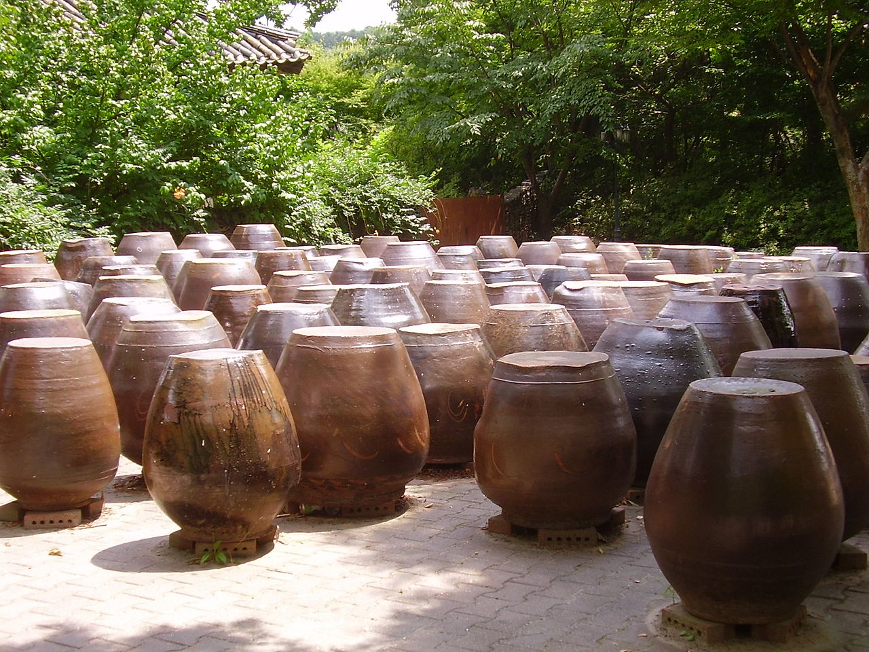
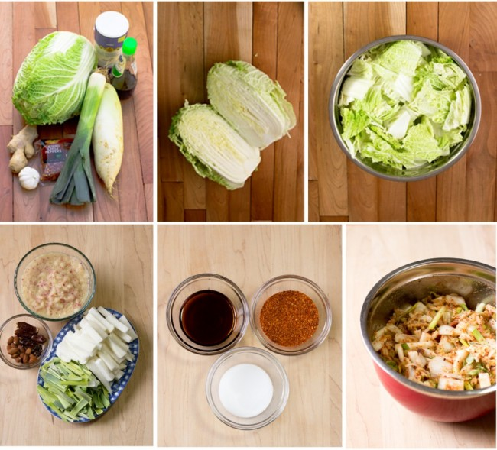
kimchi
Kimchi in jars
Korea

Slide 42
Kimchi
Ingredients:
Chinese (Napa) cabbage, salt and water. Kimchee may contain radish, green onion, red pepper powder, garlic, and ginger.
Process:
The vegetable ingredients are all received cold and stored cold (refrigerated).
Preparation involves rinsing soils off vegetables and trimming them to desired cuts. A red pepper and salt paste is made.
A short 2-3 h salt soak is used to soften the cabbage leaves in preparation for fermentation. That salt is rinsed off with clean water.
The red pepper paste is then rubbed into the Napa cabbage leaves. Generally, the natural lactic acid bacteria will provide the fermentation.
Ferment. Kimchi is fermented at three different temperatures.
2-5ºC 10-14 days | 5-15ºC 7 days | 15-25ºC 3 days
Refrigerate. Rapid cooling slows the development of acid/fermentation when using the 5-25ºC fermentation temperatures. Because psychrotrophic lactic acid bacteria are present, fermentation will continue under refrigeration. This makes the kimchee shelf life short.
The typical ending pH is 4.3 to 4.5. Highly acidic kimchee is not desired.
Rec
Prep
Salt/Soak
Then Rinse
Rub in spice
Ferm
Refr
Stor
Sell

Slide 43
STARCHES
Miso
Tofu/Tempeh
Natto
Alcoholic
paste
soy sauce
tamari
solids
juice extract
beer
sake
Breads

Slide 44
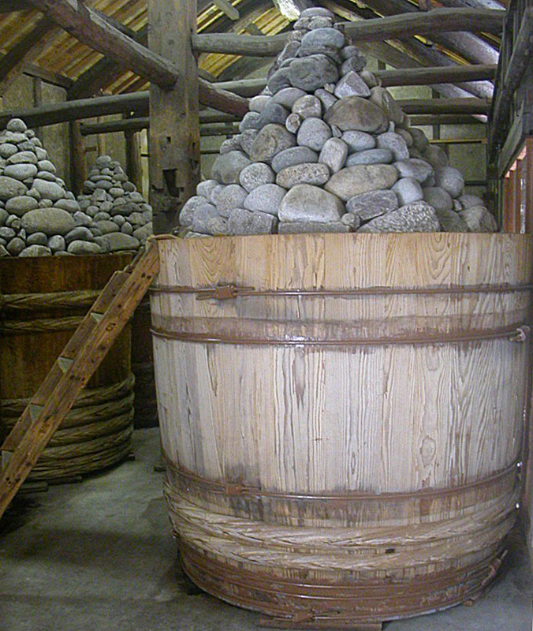
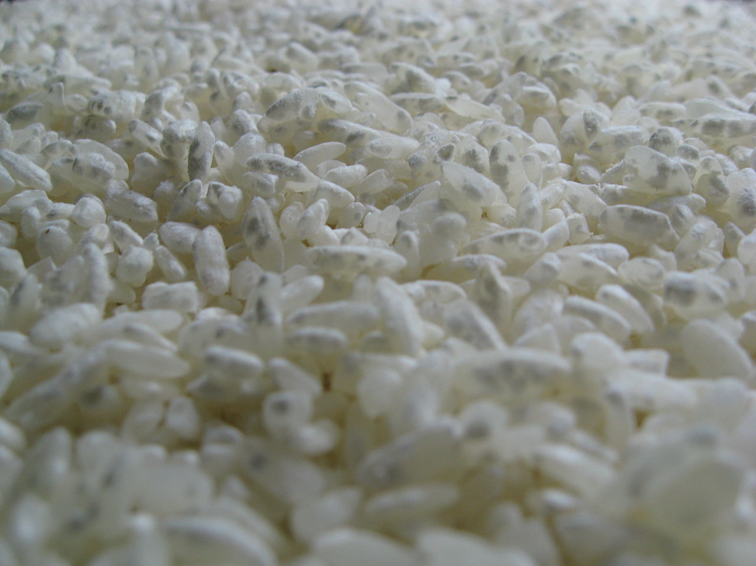
Miso
Koji
barrel

Slide 45
Koji
Ingredients: A starch source (soybean, barley, rice, wheat, etc) + Aspergillus oryzae (spores)
Process: The ingredients are all received dry and stored dry.
Preparation involves soaking the grain(s) to begin softening them.
Steam is used to cook the grains resulting in gelatinization. This is needed to swell the starch grains and release the smaller chains of starch (pectin and amylopectin).
The steamed starch is cooled just to the point not to kill the mold spores.
Ferment. Spores of Aspergillus oryzae or koji-kin are sprinkled onto the gelatinized starch. The spores grow to produce a bed of mold usually under high humidity. As the mold grows it produces high levels of amylases and proteinases (the enzymes needed to convert starch into sugars and break down proteins into amino acids).
Protein ⇢ amino acids (glutamate)
Glutamate is the umami flavor!
Dry. The mold is allowed to dry out (reduced humidity) on the dried grains. The result is koji, the source of starch and protein degrading enzymes. When koji is used in product fermentations the enzymes are already present. It is not expected that the koji needs to grow.
Rec
PREP Soak
starch grain
Steam
Ferm
Dry
Stor
Koji (kin)
cool

Slide 46
Miso
Ingredients:
Cooked soybeans, salt, water, and koji.
Process:
The dry ingredients are all received dry and stored dry.
Preparation involves cooking soybeans to gelatinize the soybean starches. Salt is added to favor the correct natural fermentations. Koji is added and the paste is held at warm temperatures to encourage enzymatic actions.
Ferment/Age. Koji enzymes break down the soybean proteins, starches, and fats into amino acids, sugars, and fatty acids. Sugars are degraded by bacteria such as Pediococcus halophilus and Lactobacillus delbrueckii, to form lactic acids (flavor and acidity). Yeasts turn sugars into alcohols for aroma. The proteinases from koji break down amino acids into glutamate (umami). The longer the aging process the greater the flavor development.
As fermentation proceeds, liquids can be drained from the miso paste. This is known as traditional tamari. Modern tamari and soy sauce are processed derivatives of the natural tamari from miso.
Rec
Prep
Steam
add koji inoc.
Ferment
Age
Stor
Stor
Miso paste
Tamari

Slide 47
cured, fermented …
MEATS
Dry sausage
Semi-dry sausage
USDA: dried to MPR 1.9:1 = shelf stable
Food Code: ≤ 0.85 aW
USDA: pH ≤ 4.5 & aW ≤ 0.91 = shelf stable
Food Code: ≤ 0.85 aW

Slide 48
Italian-type
Salami
Genoa salmi
Coppa
Soppreseta
Toscana
Pancetta
Prosciutto
Pepperoni
Breseola
S. European type
Saucisson
Fuet
Chorizo
Soujoul (Turkish)
Germanic type
Summer sausage
Thuringer
Hard salmi
Cervelat
Landjager
Lebanon bologna
Baquette salami
Westphalia salami
Teewurst
Schlackwurst
+300-400 more of various recipes

Slide 49
Sausage
Ingredients:
Pork, beef, other meats, spices, casings; cure mix (nitrites)
Process:
The ingredients are all received cold and stored cold (refrigerated). Note trichinae concerns for pork and correct nitrite usage concerns.
Preparation involves grinding and blending. Each variety will have a preferred grind coarseness. Metzger’s typically add ice during grinding to keep the meat cool. After grinding spices, etc are mixed in. Should have meat out ≤ 2 h until inoculated. Generally, a purchased lactic acid bacterial starter is added to provide the fermentation.
Stuffing sausage into casings follows the grinding and mixing steps.
Ferment. The meat is fermented at approx. 110F (varies) to pH 5.3 to inhibit S. aureus (toxin), then to its target product level. Degree hours are used here.
Optionally, some sausages are smoke flavored.
Dry. After fermentation, the cured, fermented sausage is aged until it dries to the desired finished water activity. Many will develop a white mold on the casing (not a concern).
Packaging. Note that the USDA permits (and encourages) vacuum packaging of semi dry fermented sausages, especially those sliced.
Cured, fermented,
Rec
Grind / Prep
Stuff
Ferm
Dry
Stor
Sell
Package?
Pasteurize
≥ 130F ≥ 30 m
aW / pH target
pH ≤ 5.3 deg h
USDA performance standards (log reductions of E. coli O157, Salmonella, and L. monocytogenes).

Slide 50
MISC.
Nut cheeses
Fish sauces
Black garlic*
Alcoholic
soy sauce
tamari
paste
> 10% salt required ↓ pathogens
beer
sake
not a true fermentation

Slide 51
Hazards and controls
Salmonella is associated with nuts!
Nut cheese HACCP
 | A
 | Heat Nut Milk
 | ≥ 145ºF 30 m
 | Pasteurization
 | “No longer raw”
Control?
 | B
 | Blanch Nuts
 | ≥ 190ºF 2 m
 | Only heats surface
 | Is this still raw?
Control?
 | C
 | Buy nuts pasteurized
 | Safe
 | Get LoG (Letter of Guarantee)
 | “Raw?”
Control?
D. Or, wash nuts carefully to minimize presence of Salmonella. Ferment nut milk to cheese and risk foodborne illness in the same manner as any “fresh” product.
E. Determine if pH and acids reduce Salmonella during fermentation or aging (not researched yet).

Slide 52
FERMENTATION
HACCP

Slide 53

HA+CCP
7 STEPS (Principles)
01
02
03
04
05
06
Food Safety System
Hazard Analysis
Controls
05
+
CRITICAL LIMITS
VERIFICATIONS
CORRECTIVE ACTIONS
HAZARDS ANALYSIS
MONITORING
IDENTIFY CONTROLS
PC = supplier, allergen,
or sanitation control
Hazard Analysis
CCP Summary

Slide 54
HACCP
7 STEPS (Principles)
01
CCP
GFP
GMP
PC
Preventive Controls
Critical Control Points
Good Fermentation Practices
Good Manufacturing Practices (21 CFR 117)
Significance
HAZARDS ANALYSIS
If a significant hazard requires control –at this step-- (otherwise foodborne illness is possible) a CCP or PC control is required.

Slide 55
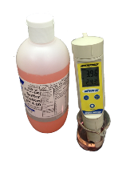
These hazards are found in unclean water and on many raw materials.
Raw produce frequently has pathogens related to animal fecal material in soils or water.
Micro Hazards
 | Dirty water | Pasteurization | pH ≤ 4.6 | pH ≤ 4.2 | ≤ 41ºF
E. coli O157 | ⚠️ | 🚫 | ⚠️ | 🚫S | 🚫S
Salmonella | ⚠️ | 🚫 | ⚠️ | 🚫S | 🚫S
C. botulinum spores | ⚠️ | ⚠️ | 🚫S | 🚫S | 🚫S
L. monocytogenes | ⚠️ | 🚫 | ⚠️ | 🚫 | ⚠️
Yeast/mold* | ⚠️ | 🚫 | ⚠️ | ⚠️ | ⚠️
Parasites | ⚠️ | 🚫 | ⚠️S | ⚠️S | 🚫S
S=survival *=spoilage = hazard
⚠️

Slide 56

Microbiological Hazards
Bacteria, Yeast, Mold, Water parasites
Hazards
Raw materials may likely contain any or all of these microorganisms
Refrigeration / Label
GFP
No Pasteurization by choice
Cold holding increases shelf life and limits pathogens and spoilage
GMP
Wash raw materials (produce) to minimize pathogens
Fermentation
Maintaining Hygiene
GFP
CCP
Achieving a fermentation pH of 4.6 or below as rapidly as possible inhibits the growth of C. botulinum
Ferment to pH 4.2 or below and demonstrate a 5 log reduction of E. coli O157 and Salmonella. Hold under acid conditions.
Preventing contamination during and after pasteurization

Slide 57
Chemical Hazards
Allergens, Pesticides
Hazards
Raw materials may contain allergens and may have pesticide residue
Allergens
PC
GMP
Pesticide residues
Ensure that allergens are properly disclosed on the product label
Wash raw materials that might contain pesticide residues
Maintaining Hygiene
GMP
GMP
Allergens
Preventing allergen cross contact
Schedule allergen products separate and after non-allergen products

Slide 58

Q&A Session

Slide 59
Thank you for your participation in today’s sharing session!
For more information about NACCHO’s Food Safety Program, contact:
foodsafetyinfo@naccho.org
Amy Chang(achang@naccho.org; 202-507-4221)
http://www.naccho.org/programs/environmental-health/hazards/food-safety

