Slide 1
Community Health Needs Assessment
Countryside Public Health
Big Stone, Chippewa, Lac qui Parle, Swift and Yellow Medicine Counties

Slide 2
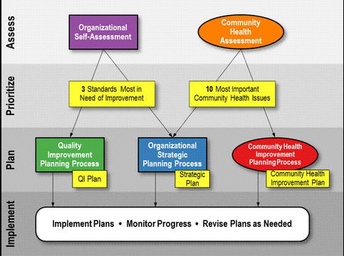

Slide 3
Countryside’s Plan
Organizational Self-Assessment
Strategic Planning meeting with Countryside Board and staff already completed.
Decision made to work on Vision Element – Competent Workforce – training to be done over 2014 with University of MN Extension
Community Health Assessment
All hospitals (9) in the five counties are meeting and conducting assessments as required by the Affordable Care Act.
Countryside also doing an assessment of the five counties as required by the Minnesota Department of Health. Countryside is working in partnership with the hospitals as well.

Slide 4
Countryside Population by Race, 2011
Notes:
County Health Tables

Slide 5
Population by Age and Sex, 2011

Slide 6
Leading Cause of Death, 2011
Countryside
State of Minnesota
 | All Ages
Cause | Rank | Number
Alzheimer's Disease | 7 | 17
Cancer | 2 | 129
Cirrhosis | 12 | 4
Chronic lower respiratory dis. | 3 | 38
Diabetes | 8 | 15
Heart Disease | 1 | 140
Hypertension | 12 | 4
Nephritis | 9 | 11
Parkinsons | 10 | 8
Pneumonia and Influenza | 6 | 20
Pneumonitis due to solids/liquids | 11 | 5
Septicemia | 12 | 4
Stroke | 4 | 35
Suicide | 15 | 3
Unintentional Injury | 5 | 30
 | All Ages
Cause | Rank | Number
Alzheimer's Disease | 6 | 1,449
Cancer | 1 | 9,468
Cirrhosis | 13 | 436
Chronic lower respiratory dis. | 4 | 2,174
Diabetes | 7 | 1,179
Heart Disease | 2 | 7,234
Hypertension | 11 | 489
Nephritis | 8 | 708
Parkinsons | 12 | 475
Pneumonia and Influenza | 10 | 669
Pneumonitis due to solids/liquids | 15 | 321
Septicemia | 14 | 338
Stroke | 5 | 2,145
Suicide | 9 | 684
Unintentional Injury | 3 | 2,309

Slide 7
Leading Cause of Death under Age 75, 2011
 | All Ages |  | Premature |  | Age Group
Cause | Rank | Number | Rank | Deaths | 0-4 | 5-14 | 15-24 | 25-44 | 45-54 | 55-64 | 65-74 | 75+
Cancer | 2 | 129 | 1 | 45 | 0 | 0 | 0 | 4 | 7 | 13 | 21 | 84
Heart Disease | 1 | 140 | 2 | 39 | 0 | 0 | 0 | 0 | 1 | 22 | 16 | 101
Unintentional Injury | 5 | 30 | 3 | 18 | 0 | 0 | 5 | 7 | 2 | 1 | 3 | 12
Chronic lower respiratory dis. | 3 | 38 | 4 | 9 | 0 | 0 | 0 | 0 | 0 | 0 | 9 | 29
Stroke | 4 | 35 | 5 | 6 | 0 | 0 | 0 | 0 | 2 | 1 | 3 | 29
Suicide | 15 | 3 | 6 | 3 | 0 | 0 | 0 | 3 | 0 | 0 | 0 | 0
Alzheimer's Disease | 7 | 17 | 7 | 2 | 0 | 0 | 0 | 0 | 0 | 1 | 1 | 15
Diabetes | 8 | 15 | 7 | 2 | 0 | 0 | 0 | 0 | 1 | 0 | 1 | 13
Cirrhosis | 12 | 4 | 9 | 1 | 0 | 0 | 0 | 0 | 0 | 1 | 0 | 3
Nephritis | 9 | 11 | 9 | 1 | 0 | 0 | 0 | 0 | 0 | 0 | 1 | 10
Pneumonitis due to solids/liquids | 11 | 5 | 9 | 1 | 1 | 0 | 0 | 0 | 0 | 0 | 0 | 4
Septicemia | 12 | 4 | 9 | 1 | 0 | 0 | 0 | 0 | 0 | 0 | 1 | 3
Hypertension | 12 | 4 |  | 0 | 0 | 0 | 0 | 0 | 0 | 0 | 0 | 4
Parkinsons | 10 | 8 |  | 0 | 0 | 0 | 0 | 0 | 0 | 0 | 0 | 8
Pneumonia and Influenza | 6 | 20 |  | 0 | 0 | 0 | 0 | 0 | 0 | 0 | 0 | 20

Slide 8
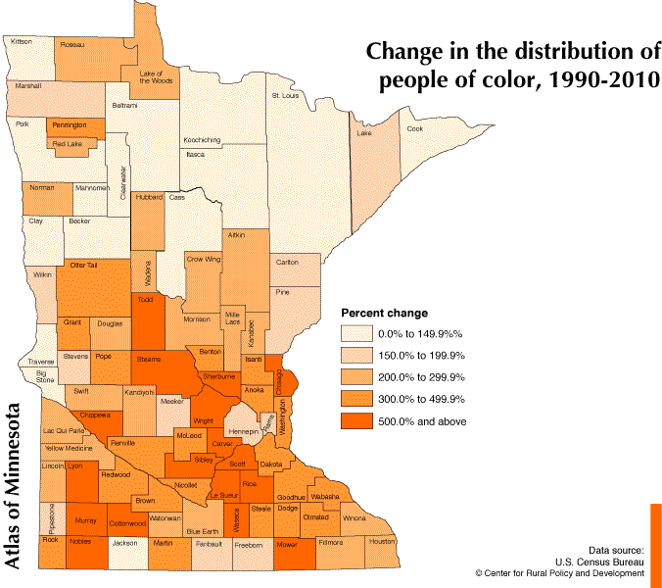
Big Stone – 75% Chippewa – 549.09 %
Lac qui Parle – 200 %
Swift – 224.05 %
Yellow Medicine – 291.31 %

Slide 9
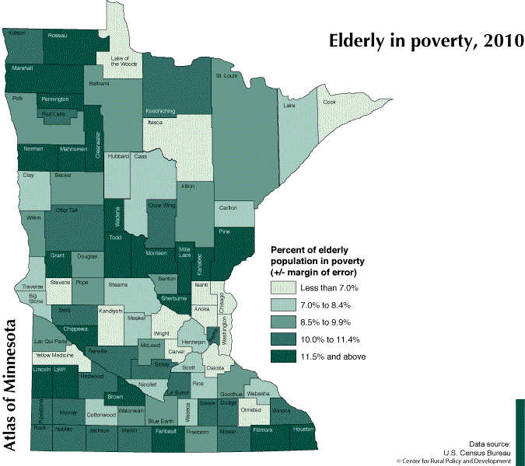
Big Stone – 7.4 %
Chippewa – 13.4 %
Lac qui Parle – 9.7 %
Swift – 11 %
Yellow Medicine – 6.5 % (5 year estimate 2006-2010)

Slide 10
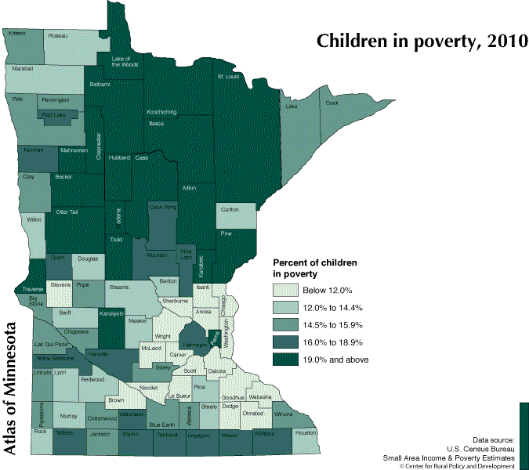
Percentage of children under the age of 18 in poverty
Nationwide – 21.6% Minnesota – 15.0%
Big Stone – 15.7 %
Chippewa – 13.4 %
Lac qui Parle – 12.1 %
Swift – 13.3 %
Yellow Medicine – 13.3%

Slide 11
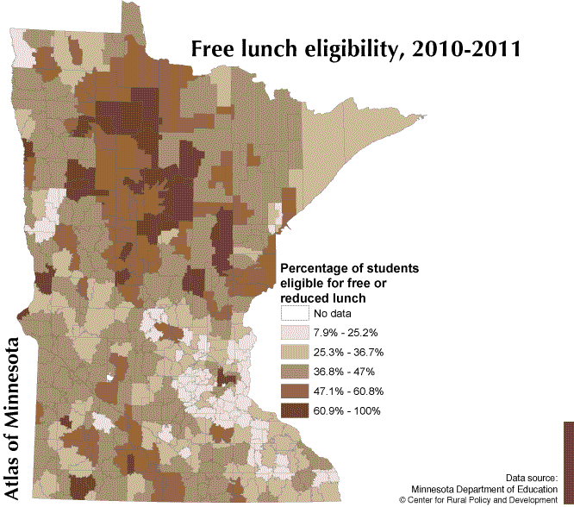

Slide 12
Free and Reduced Lunches
County | School District | Percentage on F/R Lunch
Big Stone | CGB | 44.51
Big Stone | Ortonville | 43.85
Yellow Medicine | YME | 43.63
Chippewa | MACCRAY | 42.67
Lac qui Parle | Dawson-Boyd | 42.52
Yellow Medicine | Canby | 41.6
Swift | KMS | 41.57
Chippewa | Montevideo | 38.61
Swift | Benson | 34.91

Slide 13
Federal Poverty Guidelines
2010-2011 School Year
2013-2014 School Year
Household Size | Federal Guidelines | Free Meals (130%) | Reduced Meals (185%)
1 | 10,830 | 14,079 | 20,036
2 | 14,570 | 18,941 | 26,955
3 | 18,310 | 23,803 | 33,874
4 | 22,050 | 28,665 | 40,793
5 | 25,790 | 33,527 | 47,712
6 | 29,530 | 38,389 | 54,631
7 | 33,270 | 43,251 | 61,550
8 | 37,010 | 48,113 | 68,469
Household Size | Federal Guidelines | Free Meals (130%) | Reduced Meals (185%)
1 | 11,490 | 14,937 | 21,257
2 | 15,510 | 20,163 | 28,694
3 | 19,530 | 25,389 | 36,131
4 | 23,550 | 30,615 | 43,568
5 | 27,570 | 35,841 | 51,005
6 | 31,590 | 51,067 | 58,442
7 | 35,610 | 46,293 | 65,879
8 | 39,630 | 51,519 | 73,316

Slide 14
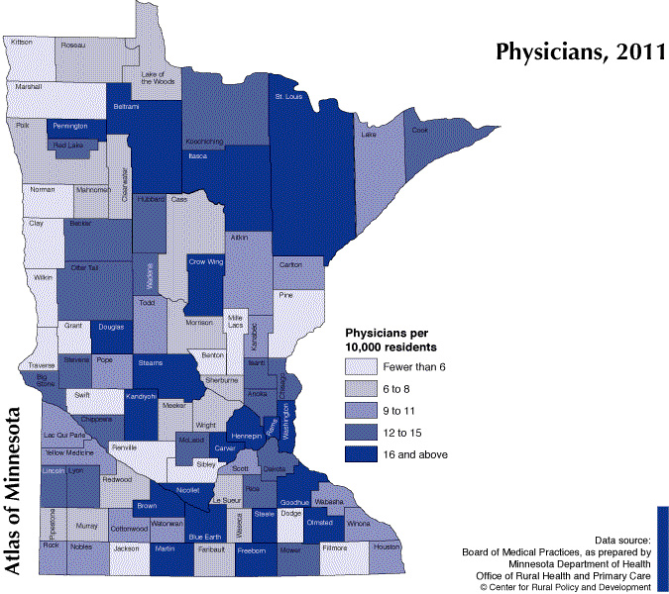
Big Stone – 13
Chippewa – 13
Lac qui Parle – 10
Swift - 5
Yellow Medicine - 9

Slide 15
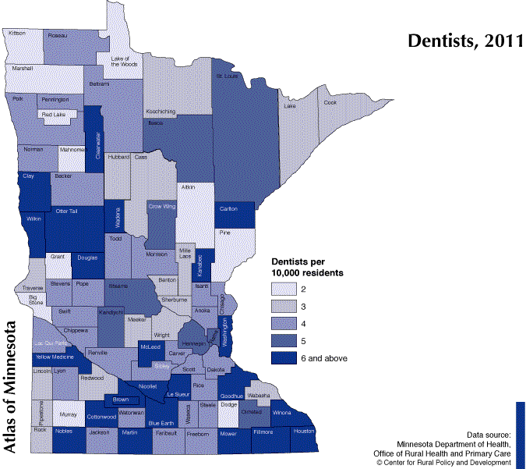

Slide 16
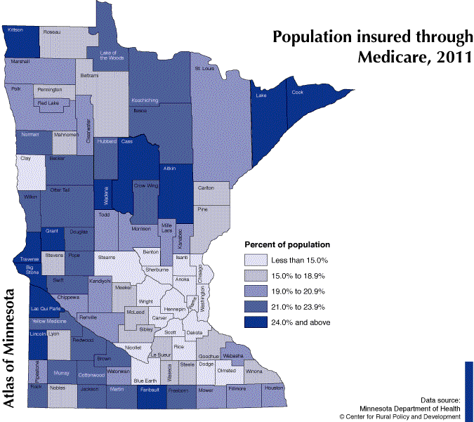
Big Stone – 27.3 %
Chippewa – 19.5 %
Lac qui Parle – 24.9 %
Swift – 19.4 %
Yellow Medicine – 23.3 %
Notes:
Calculated by dividing the total population by Medicare recipients

Slide 17
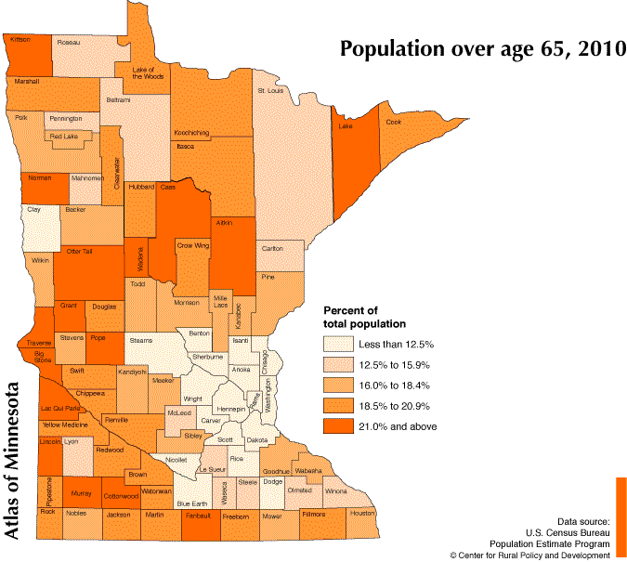
Big Stone – 25.13 %
Chippewa – 19.29 %
Lac qui Parle – 23.78 %
Swift – 20.10 %
Yellow Medicine – 19.46 %

Slide 18
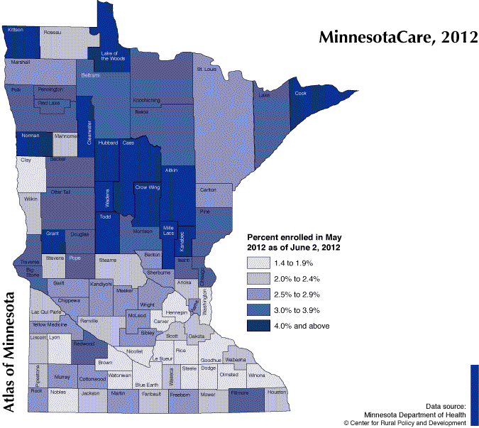
State of MN – 2.5%
Big Stone – 3.25 %
Chippewa – 2.91 %
Lac qui Parle – 2.4 %
Swift – 2.96 % Yellow Medicine – 2.93%
Notes:
Percent of Total Population Enrolled in MinnesotaCare

Slide 19
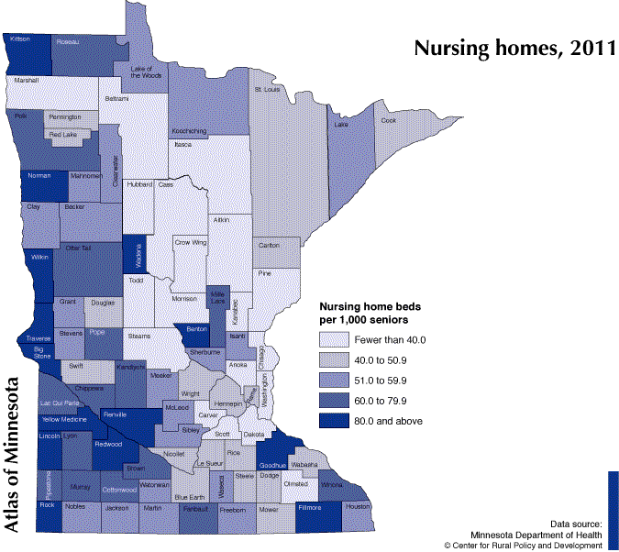
Big Stone – 86.1
Chippewa – 67.9
Lac qui Parle – 78.8
Swift – 48.8
Yellow Medicine – 90.6

Slide 20
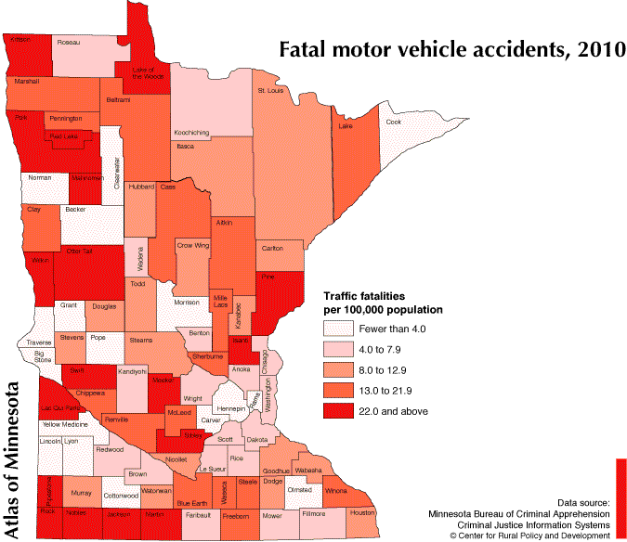

Slide 22
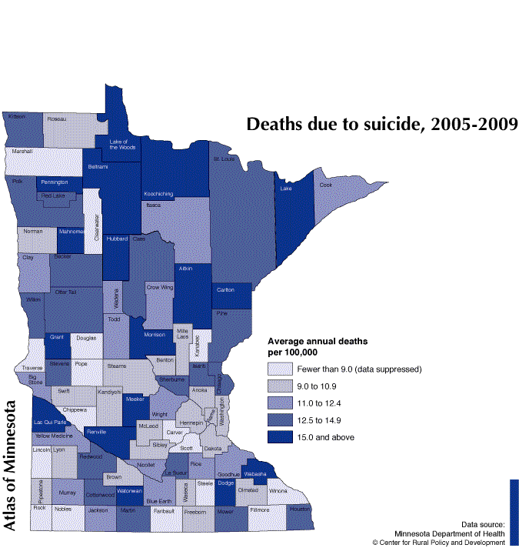
Big Stone – 11.43
Lac qui Parle – 16.88
Swift – 9.24
Yellow Medicine – 12.16

Slide 23
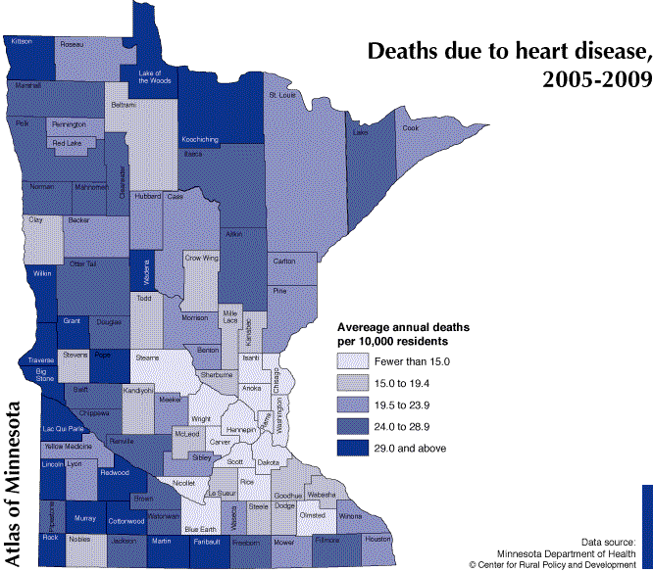
Big Stone – 38.1
Chippewa – 28.6
Lac qui Parle – 44.7
Swift – 26.8
Yellow Medicine – 23.5

Slide 24
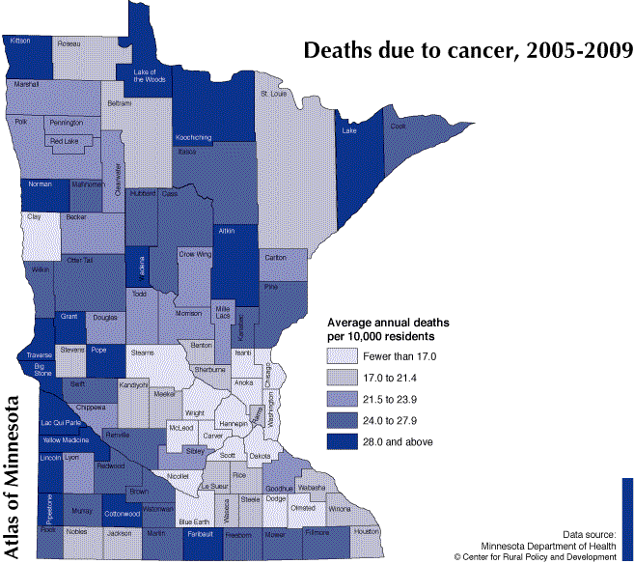
Big Stone – 38.5
Chippewa – 22.9
Lac qui Parle – 31.5
Swift – 26.6
Yellow Medicine – 31

Slide 25
Adult Health Survey, 2010
Mailed 8000 surveys to residents of Big Stone, Chippewa, Lac qui Parle, Swift, Yellow Medicine Counties
Received 2,385 completed surveys back
Completed April – July 2010

Slide 26
Have you ever been told by a doctor, nurse, or other health professional that you have …
 | Yes | No
Hypertension | 37.4 % | 61.5%
High Blood Cholesterol | 31.8 % | 68.1 %
Asthma | 11.5 % | 88.5 %
Diabetes | 10.6 % | 88.9 %
Pre-diabetes / Borderline Diabetes | 8.9 % | 90.1 %
Angina, Coronary Heart Disease | 6.0 % | 94.0 %
Heart Attack | 5.6 % | 94.4 %
Stroke | 3.1 % | 96.9 %

Slide 27
How much of a problem are the following factors for you in terms of preventing you from being more physically active?
 | Not a problem | A Small Problem | A Big Problem
Cost of fitness programs, gym memberships, or admission fees | 39.2 % | 26.6 % | 34.2 %
Lack of self-discipline or willpower | 25.6 | 43.0 | 31.4
Lack of time | 39.3 | 38.5 | 22.2
Public facilities are not open or available at the time I want to use them | 60.4 | 22.6 | 17.1
Lack of programs, leaders, or facilities | 57.8 | 27.4 | 14.9
Distance I have to travel to a place where I can be physically active | 68.0 | 18.6 | 13.5
No one to exercise with | 56.9 | 29.7 | 13.3
Long-term illness, injury, or disability | 69.9 | 17.7 | 12.4
Other Reasons | 70.3 | 20.6 | 9.0
No safe place to exercise | 86.9 | 10.2 | 2.9

Slide 28
Physical Activity Recommendations from CDC
Moderate Activity- 30 minutes or more of moderate activity per day five or more days a week
38.9 % Meets CDC recommendations
45.3 % Insufficient activity
15.8 % No moderate physical activity
Vigorous Activity- 20 minutes of more of vigorous activity per day three or more days a week
25.9 % Meets CDC recommendations
23.8 % Insufficient activity
50.2 % No vigorous physical activity

Slide 29
Tobacco
Smoking Status
18.1 % are Current Smokers
27.2 % are Former Smokers
54.7 % have Never Smoked
Other tobacco use in last 12 months
11.7 % have used other tobacco products in last 12 months
Smoking in the home
11.7 % have regular smoking in their home
Smoking in the vehicle
21.0 % regularly smoke in the vehicle

Slide 30
Health Concerns
Are you trying to lose weight?
53.7 % Yes
Have you seen a doctor, nurse, or other health professional about your health in the last 12 months?
 | Yes | No
Overall | 73.6 % | 26.4 %
18-34 | 60.0 | 40.0
35-44 | 61.9 | 38.1
45-54 | 70.8 | 29.2
55-64 | 80.8 | 19.2
65-74 | 87.6 | 12.4
75+ | 89.2 | 10.8

Slide 31
BMI
Body Mass Index
Used to estimate body fat in adult men and women based off of their Height and Weight
Higher BMI (Overweight and Obese) puts you at a higher risk of heart disease, high blood pressure, type 2 diabetes, gallstones, breathing problems, and certain cancers
Limitations
May overestimate body fat in athletes and other adults who have a muscular build.
May underestimate body fat in older persons and others who have lost muscle.

Slide 32
Health Comparison
Do you consider yourself?
BMI calculated from height & weight
Underweight - 1.9 %
2.5 % F
1.4 % M
About the right weight – 49.1 %
46.7 % F
51.5 % M
Overweight - 48.9 %
50.9 % F
47.1 % M
Not overweight – 27.7 %
36.9 % F
18.6 % M
Overweight but not obese – 35.4 %
31.3 % F
39.5 % M
Obese – 36.9 %
31.8 % F
41.9 % M

