Slide 1
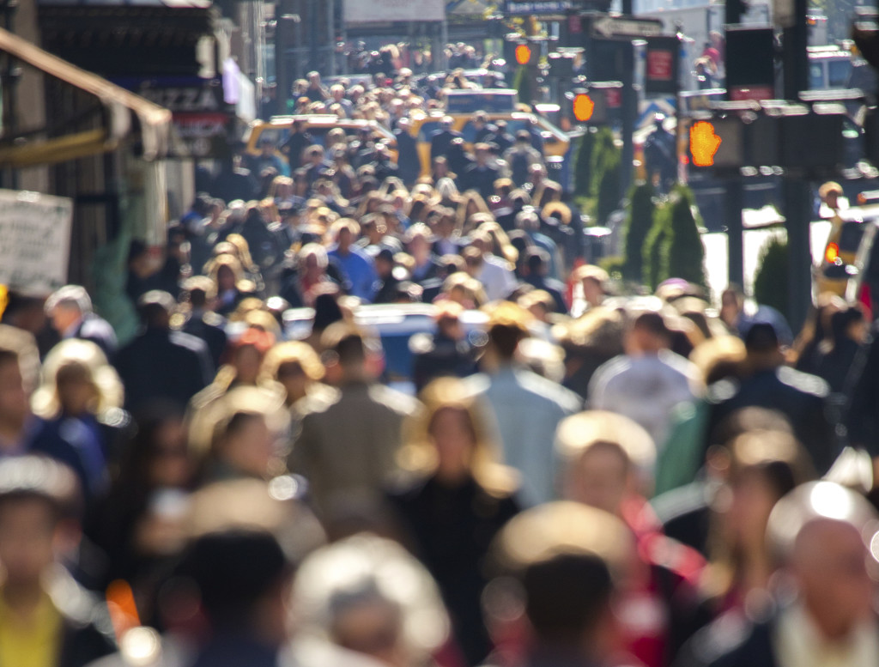
Rural and Frontier Local Health Department ​
COVID Workforce Capacity Building Project
Rural Café
Health Equity in Action: Lessons Learned and Best Practices
Welcome! This session will begin shortly.
Please change your zoom display name: your name, organization
(How to: Right Click On Yourself, Click “Rename” From List )
January 25, 2024

Slide 2
Today’s Focus
Health Equity In Action
Purpose
Participants will have the opportunity to connect with and learn from other health departments in a large-group brainstorming discussion on heath equity fundamentals and equitable strategies used in emergency preparedness and response to air quality. In this session we will spend time gaining a deeper understanding of best practices you can use to support your community to:
Stimulate effective problem solving and information sharing
Understand what has and has not worked well for LHDs when implementing health equity in emergency preparedness & response
Commit following the session to practices your LHD would like to adopt for your community

Slide 3
Agenda
1.
Today’s Focus
2.
Health Equity Fundamentals
3.
Health Equity Spotlight
4.
Health Equity in Emergency Response
5.
Closing & Follow-Up Survey

Slide 4
Who’s Joining Today’s Rural Cafe?
Health Department Representatives
NACCHO and Deloitte Team
Our Big Thinkers!
Representatives from rural and frontier health departments will have the opportunity to connect with each other and engage in meaningful conversation surrounding health equity
Our Facilitators!
Members from NACCHO’s Health Equity & Social Justice Team and Deloitte’s Technical Assistance Team will facilitate today’s discussion
CDC Office of Rural Health Representatives
Our Connectors!
Representatives from CDC may join today’s session to hear the valuable insights from local health departments firsthand and share back with their colleagues

Slide 5
Thursday, January 25, 2024
Grounding Health Equity for
Public Health Preparedness
Glenda Young Marquez, MPH
Senior Program Analyst
Health Equity & Social Justice
gymarquez@naccho.org
Charles Udeze
Program Analyst
Health Equity & Social Justice
cudeze@naccho.org
Lluvia Botello
Program Analyst
Health Equity & Social Justice
lbotello@naccho.org

Slide 6
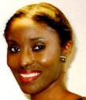
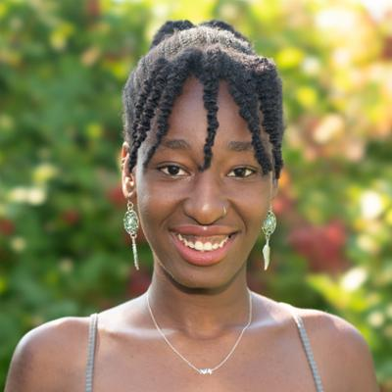
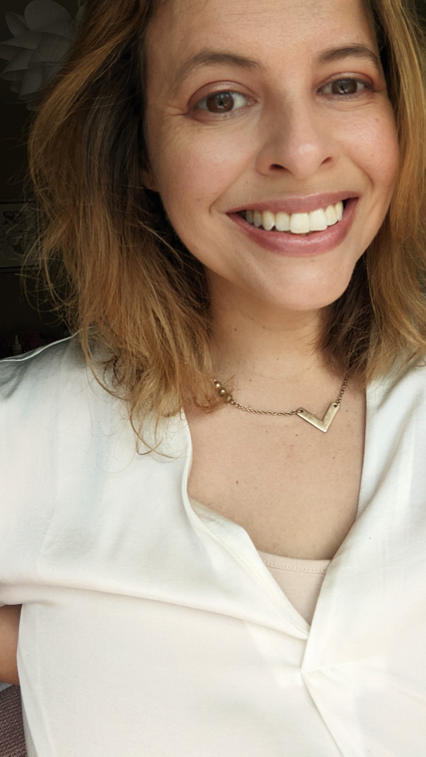
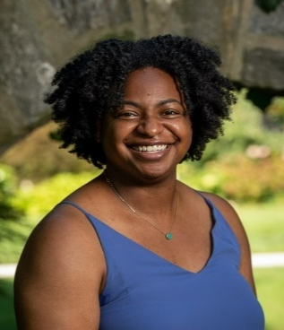
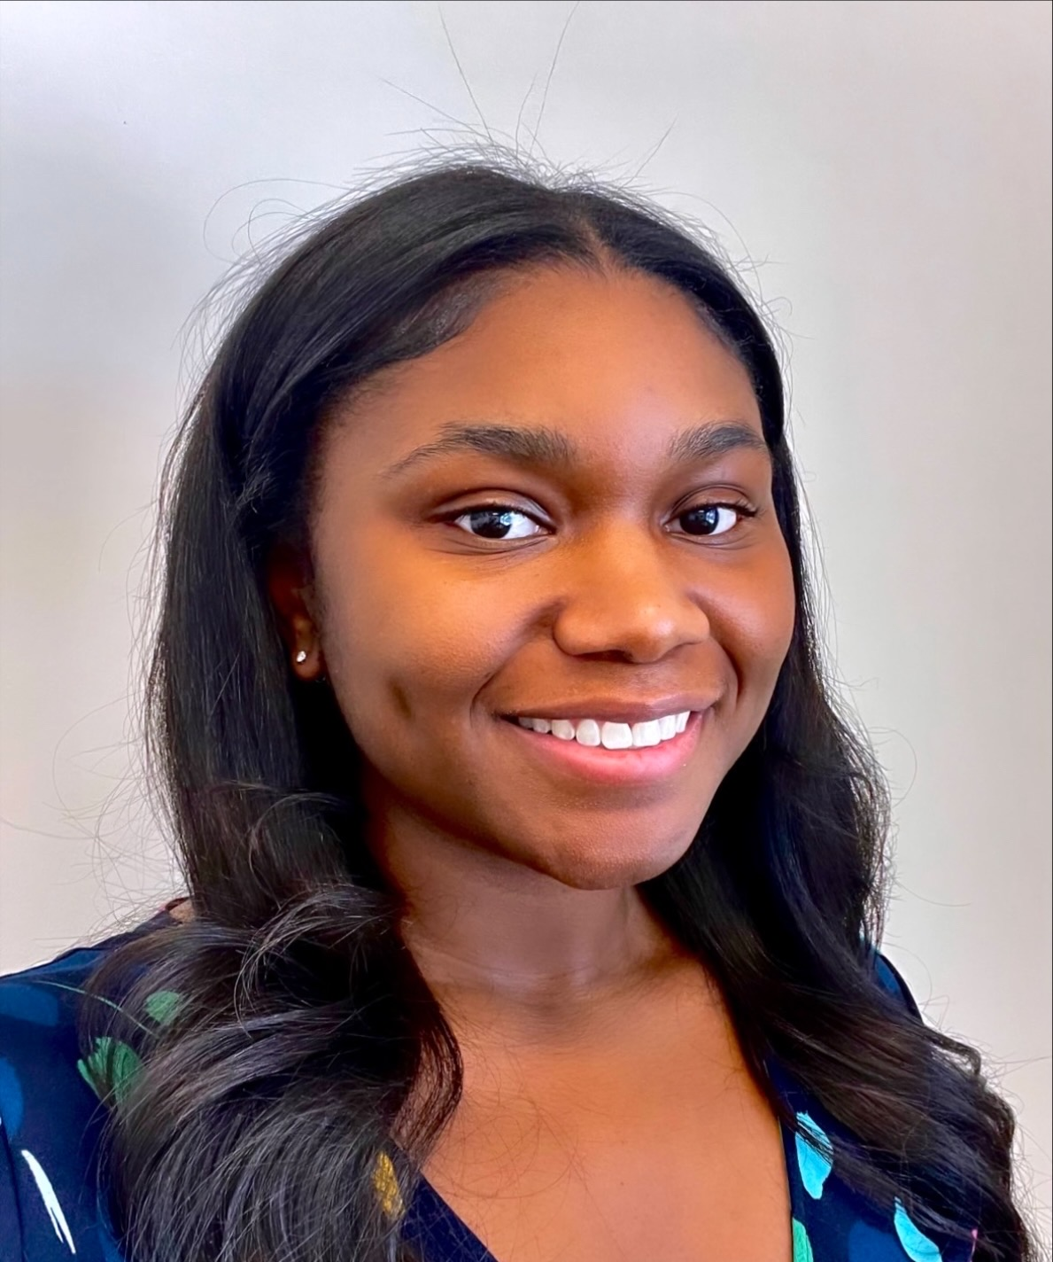
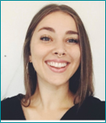
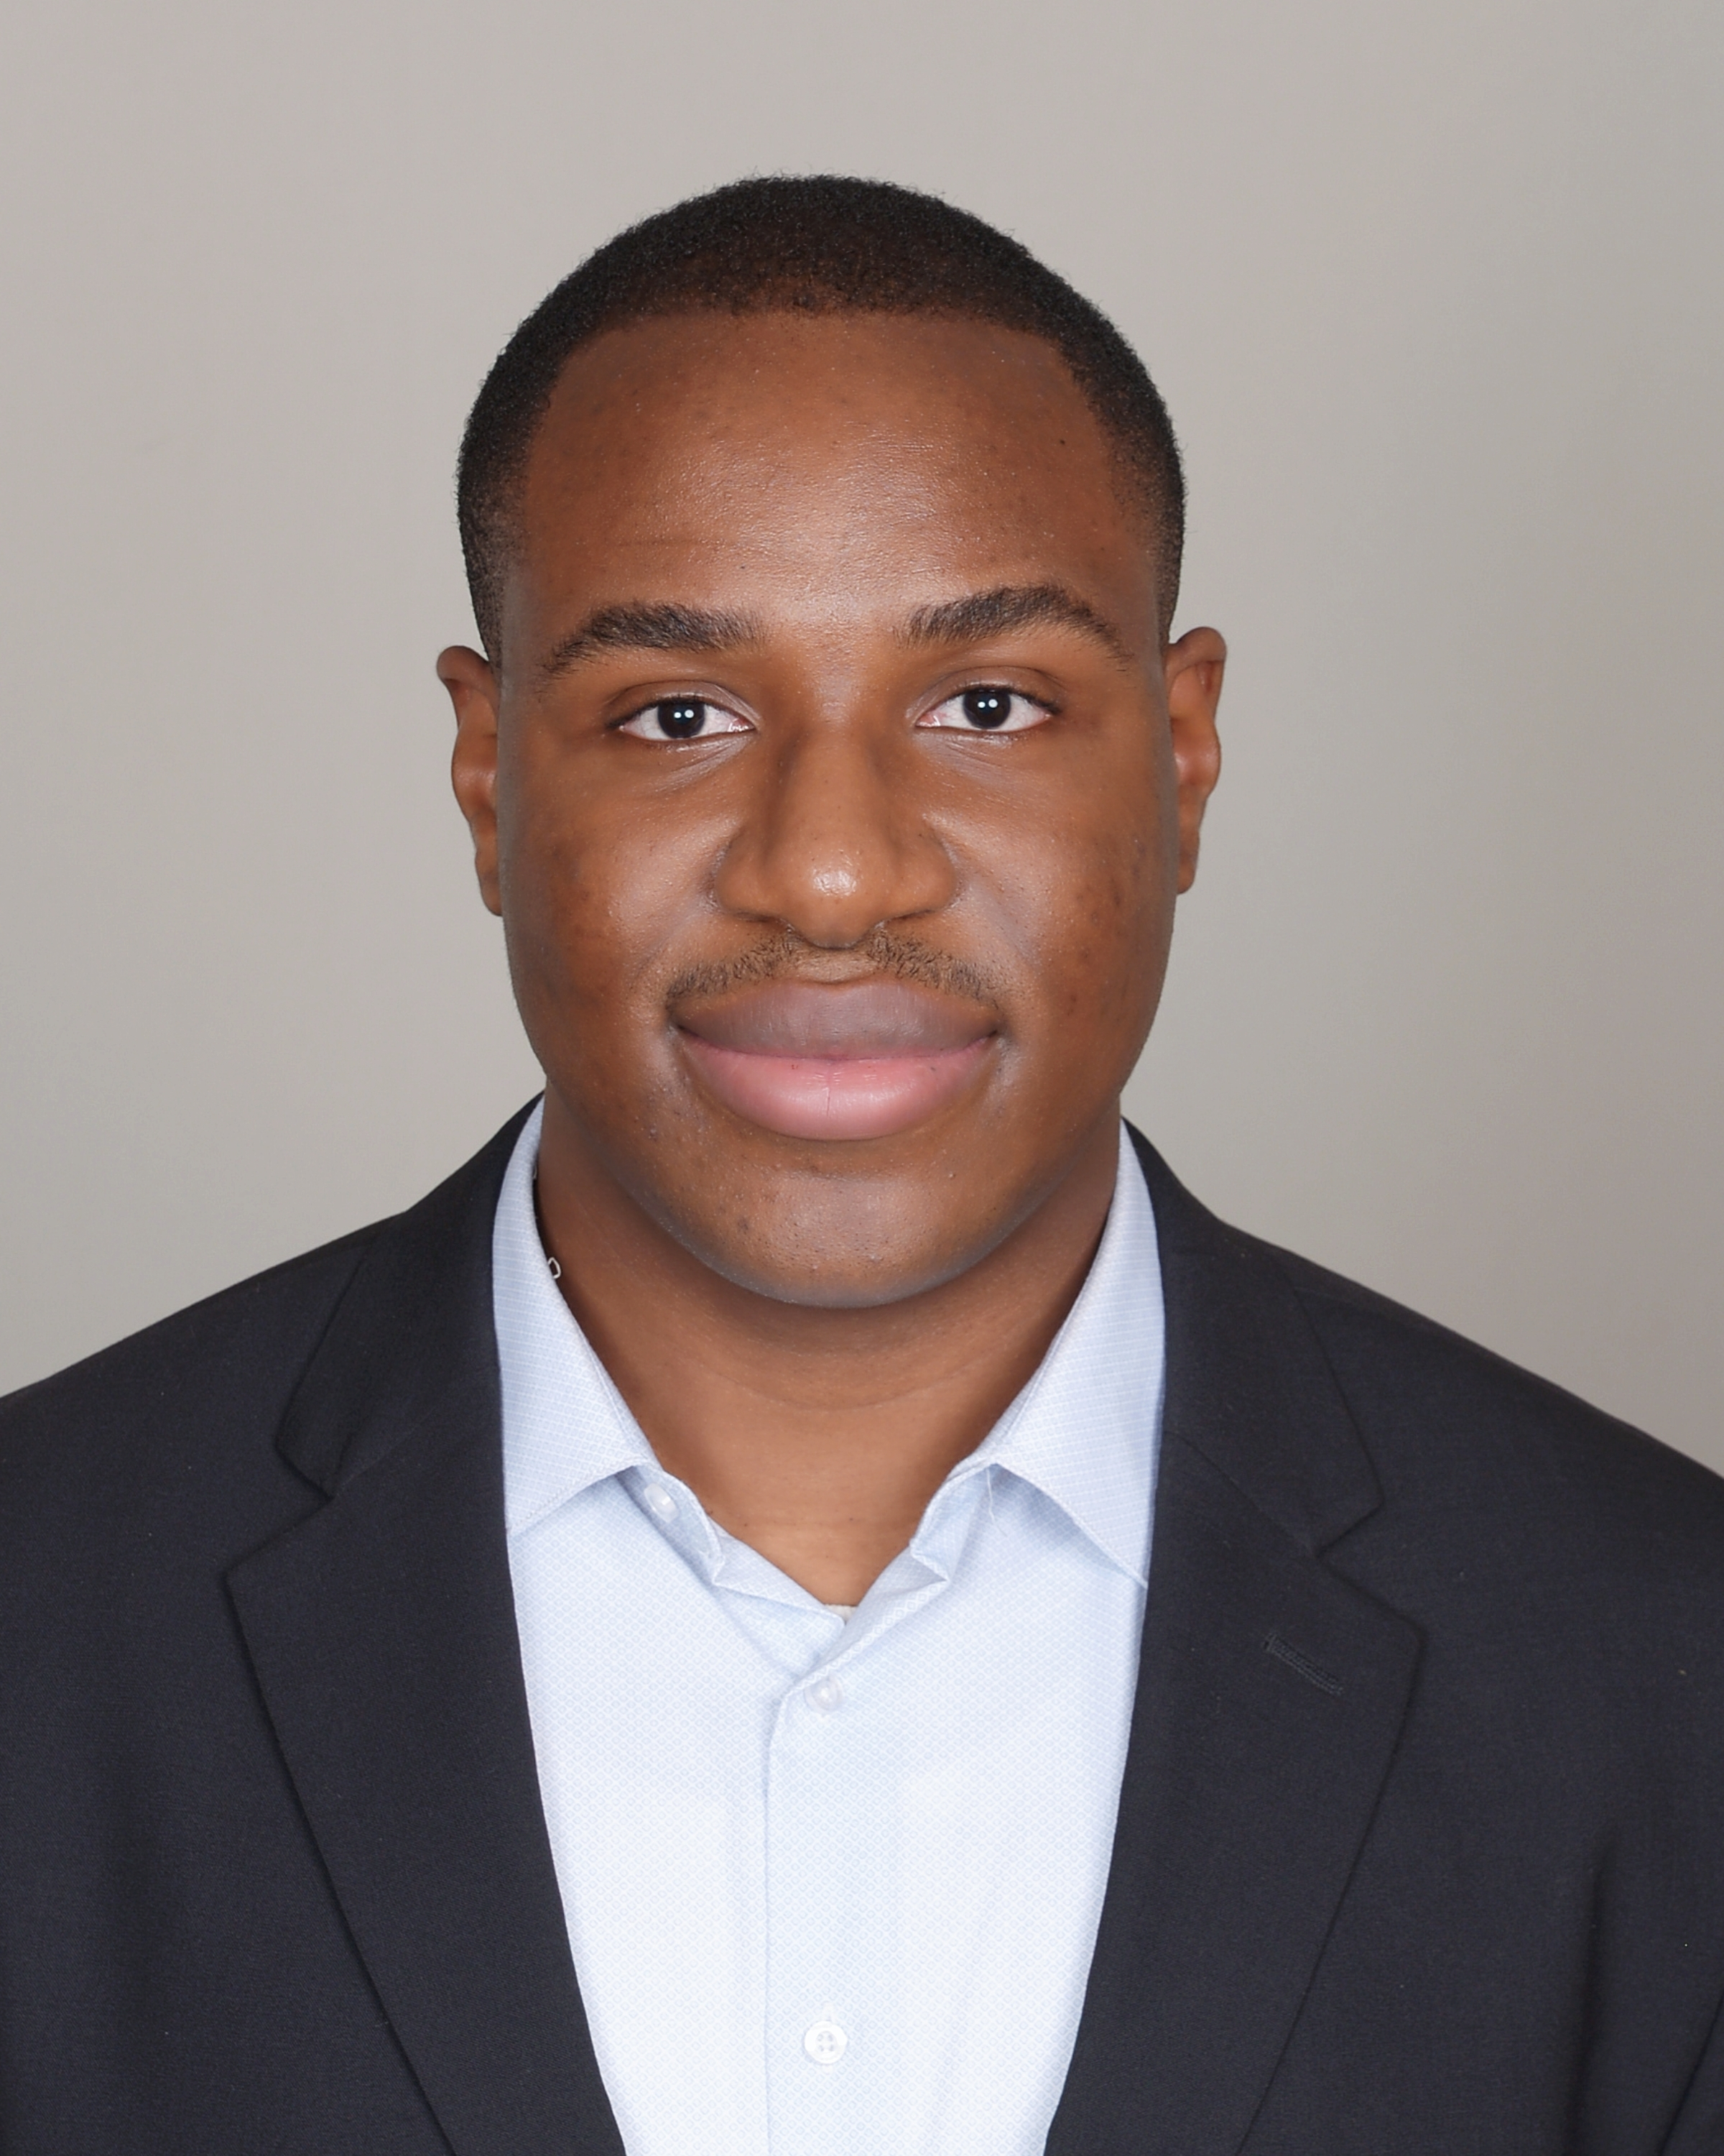
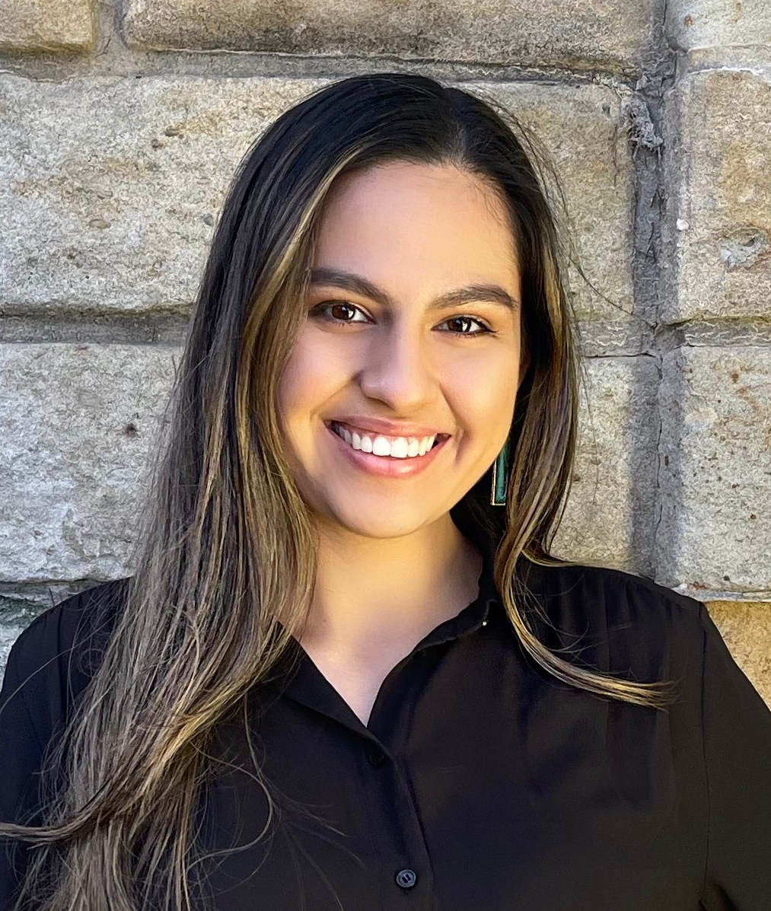
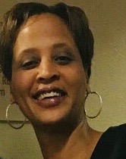
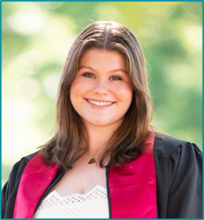
z
Health Equity & Social Justice Team
Introductions
Hassanatu Blake
(she/her)
Director
Jasmine Akuffo
(she/they)
Sr. Program Analyst
Glenda Young-Márquez
(she/they)
Sr. Program Analyst
Brianna Aldridge
(she/her)
Sr. Program Analyst
Kayla Hall
(she/her)
Program Analyst
Allie Halprin
(she/her)
Program Analyst
Charles Udeze
(he/him)
Program Analyst
Lluvia Botello
(she/her)
Program Analyst
Cheryl Gibbs
(she/her)
Sr. Program Assistant
Mya Smith
(she/her)
Sr. Program Assistant

Slide 7
What is Health Equity?
Notes:
Jasmine
Audience Engagement: What do you think of when you think of health equity? Can I get a definition?

Slide 8
Defining Health Equity
Health Equity
“Health equity is the assurance of the conditions for optimal health for all people. Achieving health equity requires valuing all individuals and populations equally, recognizing and rectifying historical injustices, and providing resources according to need.”
Source: Dr. Camara Jones, Morehouse College

Slide 9
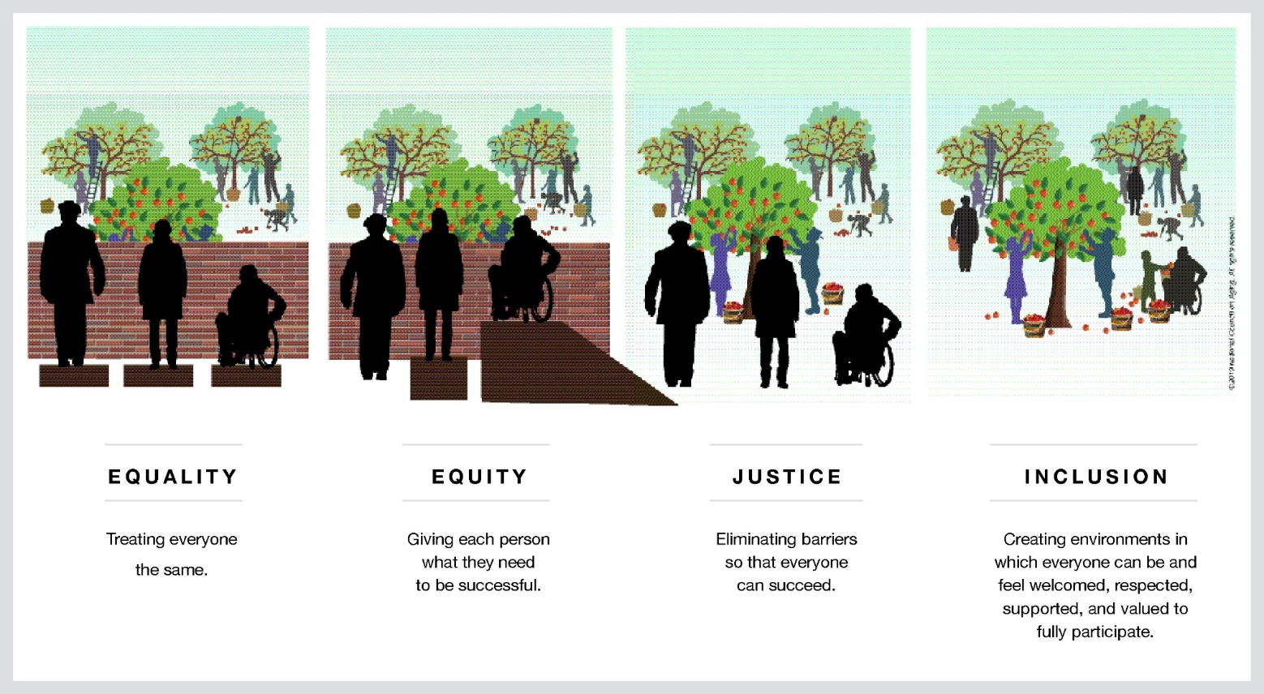
Source: NCOA
Notes:
Jasmine
This graphic, I’m sure many of you have seen, just further illustrates what we mean by equity and what we’re aiming for. For a long time, we as a country have been focused on equality. This idea that everybody deserves the exact same thing. Equity recognizes that not everybody needs the exact same things because not everybody has the same barriers or is starting from the same place.
And then I want to, also, call your attention to the right two images as well that depict justice and inclusion. Equity is both a process and an outcome, but it is not the only outcome we are striving for. It is not our end goal. It both requires and necessitates the conditions for justice, full inclusion of all people in society, and liberation. We don’t want to just help people to overcome barriers and the challenges that they face. We want to get to a point where we’ve removed those barriers completely. This is what will allow us to get to a place where we have that “assurance of conditions” that Dr. Jones describes in her work.
Next slide, please.
Audience Engagement: ask for 1-2 definitions of health equity

Slide 10
Defining Health Equity
Health Inequity refers to...
“...differences in the distribution of disease, illness, and death that are systematic, unjust, actionable, and associated with imbalances in political power.”
Source: Margaret Whitehead, “The Concepts and Principles of Equity and Health,” Intl Jrnl of Health Services 3 (1992): 429. [paraphrased]
Notes:
Jasmine
Health inequities are defined as …
This term is often used interchangeably with health disparities. The two terms overlap, but they're not necessarily the same. With health disparities, we're just talking about health differences that may or may not be the result of injustice.
When we use the language of health inequities vs health disparities, we are not simply talking about differences. We are talking about differences that exist within a broader structural context due to institutional, systematic and historical factors.
We are acknowledging the potential actor(s) that (are not just closely linked with but) create this gap / inequity
And what is really key here is that we are, also, explicitly acknowledging that these are not merely differences that are preventable, but are unjust and we can do something about them. Meaning, they are actionable.
This is different from health disparities because, technically, we could say that not all health disparities are unjust. For example, if we look at cancer rates among older adults versus adolescents. Due to the cumulative impacts of environment, experience, etc. over the life course, older adults (a 75 year old) are going to be more susceptible like conditions like cancer than youth (let’s say a 7 year old). Correct? That is a health disparity, but not necessarily a health inequity because it doesn’t point to systematic factors or imbalances in political power in the same way.
However, a disparity that exists between older black adults and older white adults that makes cancer more prevalent among older black adults would be considered a health inequity because we’re then talking about systematic differences due to the construct of race.

Slide 11
A Focus on Root Causes
Notes:
Jasmine
In order to address health inequity, we have to engage with and address its root causes. These can be defined as ….
These are different from SDOH, which are the results of….

Slide 12
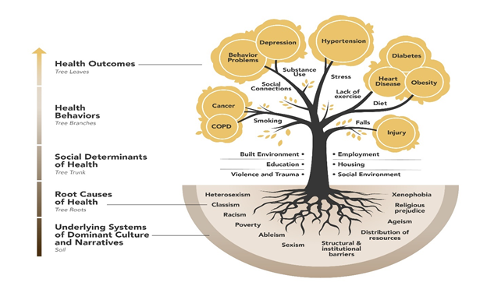
ROOT CAUSES
Health Tree Model by Health Resources in Action (HRiA)
Notes:
Jasmine
To give you a visual, we can also consider this image from HRiA that depicts how we move from the root causes to the adverse health outcomes we often across populations.
Deep in the soil we see underlying systems and narratives – which we're not going to get into today. At the roots of the tree, you can see what are just a handful of root causes. We then work up through the trunk of the tree to consider living conditions, or SDoH. We move further up the tree to the branches which represent health behaviors that are shaped by SDoH, e.g. smoking, substance use, etc. At then we get to the adverse health outcomes often shaped by these behaviors at the leaves.
Taking a couple by example, you might consider how racism through redlining set up barriers that prevented Black and Brown people from being able to take out loans for homeownership. How this, among other injustices, leads to poor access to affordable housing, environmental racism, wherein Black and Brown neighborhoods become the targets for toxic waste sites. This then leads to toxic environments – or adverse community environments, which we'll talk to later - toxic stress. This can result in high rates of asthma and other respiratory illnesses. And toxic stress can lead to subsequent poor health behaviors, like smoking, and adverse health outcomes, like cancer. These impacts then become intergenerational. So much so that, in the case of redlining, we came to see that "there was a higher prevalence of COVID-19 risk factors in historically “redlined” neighborhoods ". So, here we see how root causes create health inequities across the communities we serve.
Considering class – you might consider capitalism and how that creates different class positions. Those class positions then denote differing levels of political power, access to resources, etc. A wealthy neighborhood might have a better built environment (more green space, higher level of safety and walkability, more access to healthy food and grocery stores). A neighborhood with less economic capital and political power might lack these things. Additionally, as has often been the case historically, they might become the target for waste sites that pollute the air and environment. You may then see higher rates of asthma and other poor health behaviors and outcomes that emerge.
This list is by no means exhaustive, there are many other systems at play in society, but these are some of the more prominent and pervasive ones.

Slide 13
Questions
What health equity obstacles does that community face?
How does this affect your work?
Notes:
Think about a project you are currently working on.
What communities does that project serve?

Slide 14
Centering Community in Health
Notes:
11:10am
Jasmine

Slide 15
Who's in Community?
Notes:
Jasmine
Central to advancing Health Equity are communities. Now, communities are not monoliths. When we talk about communities, we might mean different things. We might mean the actual geographical context in which people live and reside, like a neighborhood, a town or a city. We might mean the actual community members, defined as a community by their shared context and conditions. We, also, might mean specific populations who, regardless of location, are bound by shared histories, cultures and experiences.
People and communities are at the center of the work we do around equity.
And so, harkening back to our definition: health equity requires that we value all individuals and populations / communities equally; that we acknowledge and rectify historical injustices (faced by different communities); and that we distribute resources according to need (because different communities have different needs).

Slide 16
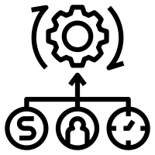
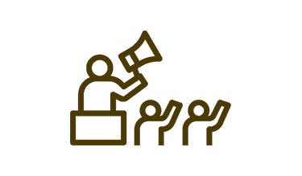
Developing Cross-Sector Partnerships
Resource sharing
Stronger base of advocates
Disrupt silos
Notes:
Jasmine
One way we can engage more with our communities for the advancement of health equity is through developing cross-sector coalitions and partnerships.
You'll find that the deepest root causes impact multiple different sectors. We in public health, as well as in many different fields, have a tendency to work in silos, even while seeking to address the same issues. Disrupting these silos across sectors and building coalitions and partnerships, can help us to 1) better diagnose the problems that we are all facing, 2) better understand the intricacies and nuances of those problems and 3) come up with more effective solutions for addressing them.
Cross-sector coalitions allow for the sharing of resources like information and data; skills and expertise; funding; and even additional partners via shared networks that can be leveraged by the collective to achieve the same ends.
We cannot do this work alone or in silos.

Slide 17
Who do we engage with in community?
Who is at the table?
Who is missing? And why?
Community Organizers / Leaders
Non-Traditional Healers
Financial Sector
City Planners
Artists / Creatives
Health Departments
Differently abled
Healthcare / Hospitals
Community-Based Orgs
Youth
LGBTQIA+
Private Sector
Immigrant
Homeless / Housing
Housing
Elected officials
Justice-involved
Local businesses
Education
Older adults
Notes:
Jasmine
Another important aspect of community engagement is who you are including. Community engagement is often thought about in terms of community organizations, which are important, but we also have to think about the actual community members we're serving.
Because it is community members and residents that are at the center of our work, it is community members who need to be at the table when planning or making decisions about issues that concern them.
Take a look at some of the bubbles here. Consider who is usually at the table when decisions are made that can impact a community. Who is often missing, why and how they can be brought to the table to share their knowledge and expertise.
Beyond community organization, what subgroups within your communities bring their own unique perspectives, experiences and expertise as residents and people who are directly impacted by the decisions made in and for their community.
For example, are the people at the table diverse in terms of:
Race and ethnicity
Differing income backgrounds
Sexuality and gender
Age
Ability Status
And more?
How can we bring them to the table? What are the barriers they might face to coming to the table? (e.g. transportation, childcare, etc.)

Slide 18
Question
What opportunities do you hope to create in your community?

Slide 19
Health Equity in Preparedness
Notes:
11:10am
Jasmine

Slide 20
Whole Community Strategic Themes
Understand community complexity.
Recognize community capabilities and needs.
Foster relationships with community leaders.
Build and maintain partnerships.
Empower local action.
Leverage and strengthen social infrastructure, networks, and assets.

Slide 21
"A more protective and positive expression of community engagement" Patel et al 2017
Community Resilience in Preparedness

Slide 22
Community Resilience in Preparedness
1. Process definitions – referring to processes of change and adaptation,
2. Absence of adverse effects- ability to maintain stable functioning,
3. Range of attributes- the ability to respond to the emergency

Slide 23
Elements of Community Resilience in Preparedness
Local knowledge
Community networks and relationships
Communication
Health:
Resources
Economic investment
Preparedness
Mental Outlook
Governance/ leadership

Slide 24
Community Resilience

Slide 25
Question
What does it mean to incorporate a health equity lens to public health preparedness?

Slide 26
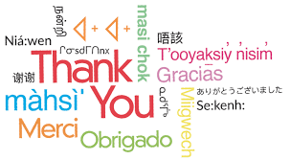
Thank you
NACCHO Resources
Roots of Health Inequity Course
MAPP 2.0 assessment tools
External Resource
Center for Community Resilience
Notes:
Hassa
MAPP - The assessments include the Community Partner Assessment, Community Status Assessment, and Community Context Assessment.

Slide 27
Health Equity Spotlight

Slide 28
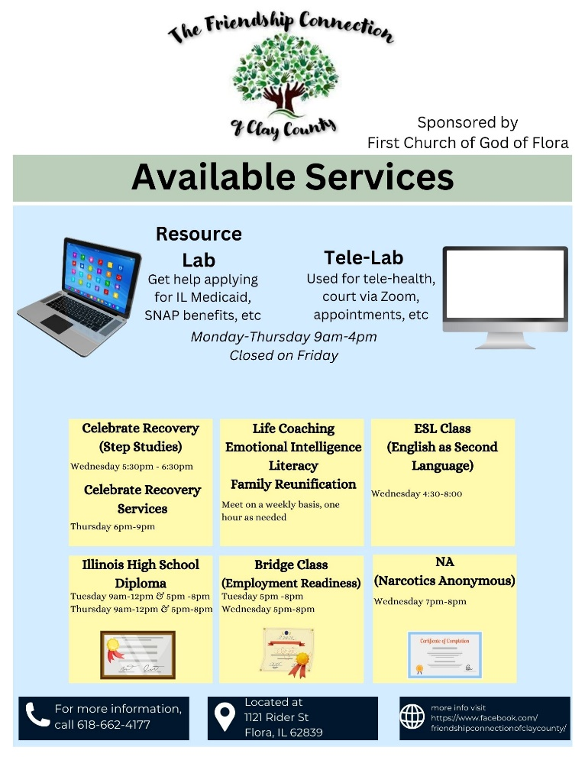
Clay County Health Department
Our Crowning Health Equity Achievement
Our crowning achievement is the strides in advancing health equities over the past year that have been made possible by our ARISE grant. We have been able to assist our community by providing access to resources they weren’t previously able to access.
In photos
Background
Health Equity Progress
Lessons Learned
The Clay County Health Department serves a county that is comprised of a tight-knit rural, agricultural community of community of higher-than state average poverty levels
The 3 Key public health challenges - Behavioral Health - Heart Disease & Obesity - Access to Care
Underlying issues of focus include lack of transportation and lack of behavioral health providers
Recent Activities
We partnered with a 501(c)(3) that was starting up in our community They were able to house & staff a resource lab, as well as a tele-lab at their facility for community members
Looking Ahead
We will continue with the partnership as long as we are able. We will continue to seek opportunities to lessen healthcare disadvantages in community
We were able to reach a larger segment of our community after partnering with another organization. Going forward, we will continue to seek & write for grants in the area of health equities.

Slide 29
Application of Health Equity in Emergency Preparedness & Response

Slide 30
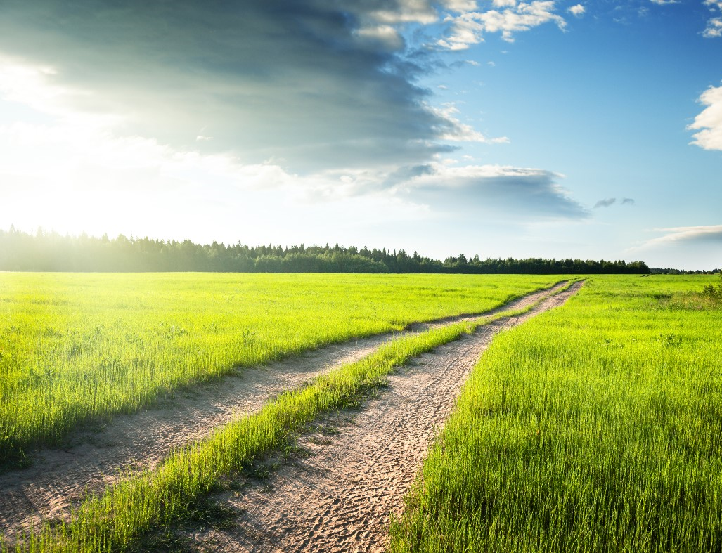
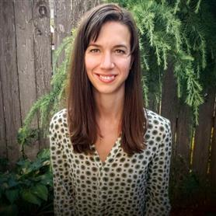
Let’s Discuss Health Equity in Emergency Preparedness & Response!
Our Facilitator
Sophia Grimm
Deloitte Manager
Subject Matter Expert
Years of Experience: 10+ years of experience in public health and emergency management supporting federal, state, and local governments.
Relevant Experience: Sophia has held key leadership roles during several emergency response operations including for COVID-19, Zika, Hurricane Florence, winter weather, and wildfire smoke incidents. These positions have taught her how to move vertically between federal, state, and local governments, as well as horizontally across jurisdictional departments.

Slide 31
Rules of the Road
Be present and in the moment – actively participate in our discussion
This is an open forum – everyone’s input is valuable, and no one is expected to have all the answers
Build on ideas and be positive – “yes, and” rather than “no, but”
Go beyond business as usual – challenge conventions and norms
Think about solutions – be creative in your improvement approaches
Assume positive intent – give others the benefit of the doubt and ask clarifying questions when unsure
Are there any other “Rules of the Road” that we want to add?

Slide 32
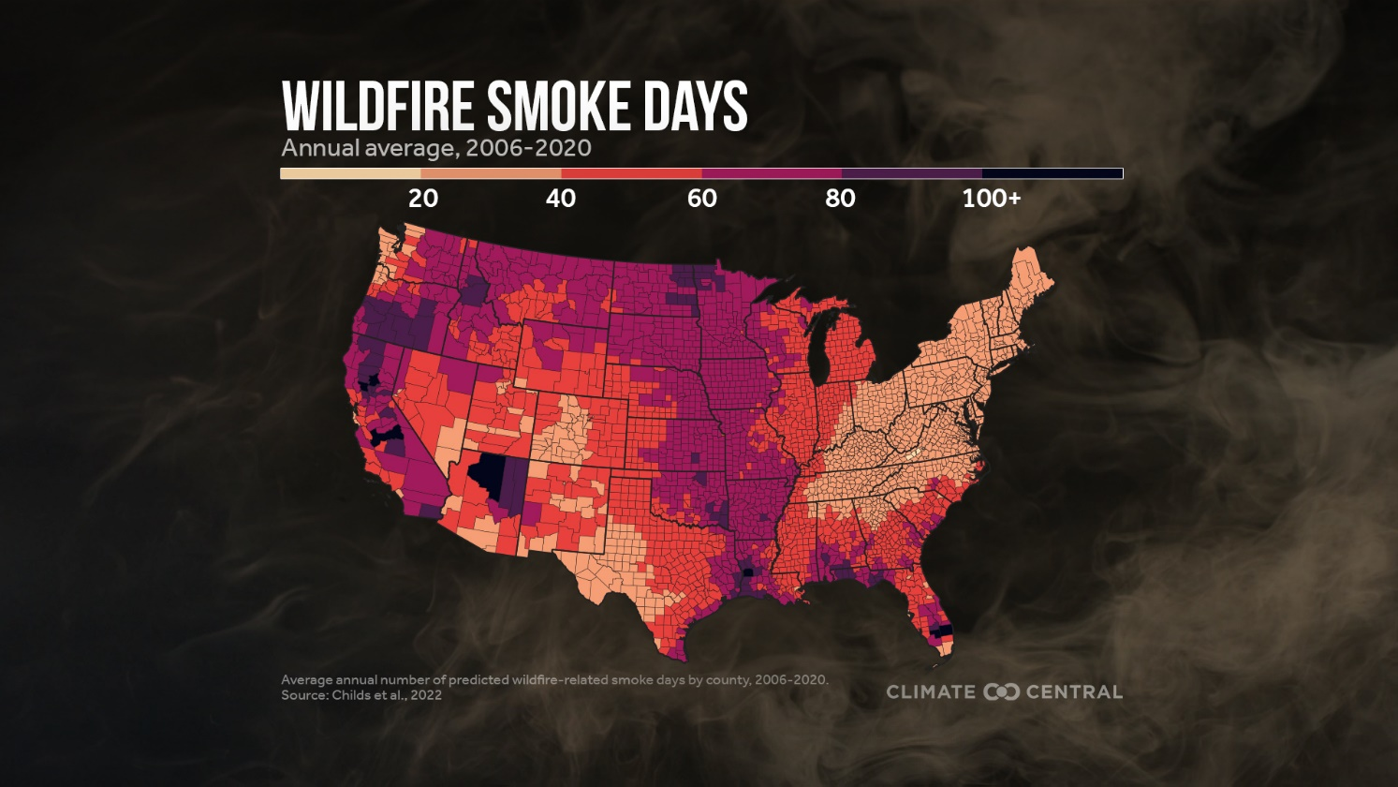
Air Quality Trends
Did You Know?
Wildfire smoke can travel far and cause harm hundreds or even thousands of miles away from where fires burn. The West has more large fires and local smoke-related pollution, but fires from the western U.S. and Canada affect the entire contiguous U.S.¹
Climate Central - Wildfire Smoke: Nationwide Health Risk ¹

Slide 33
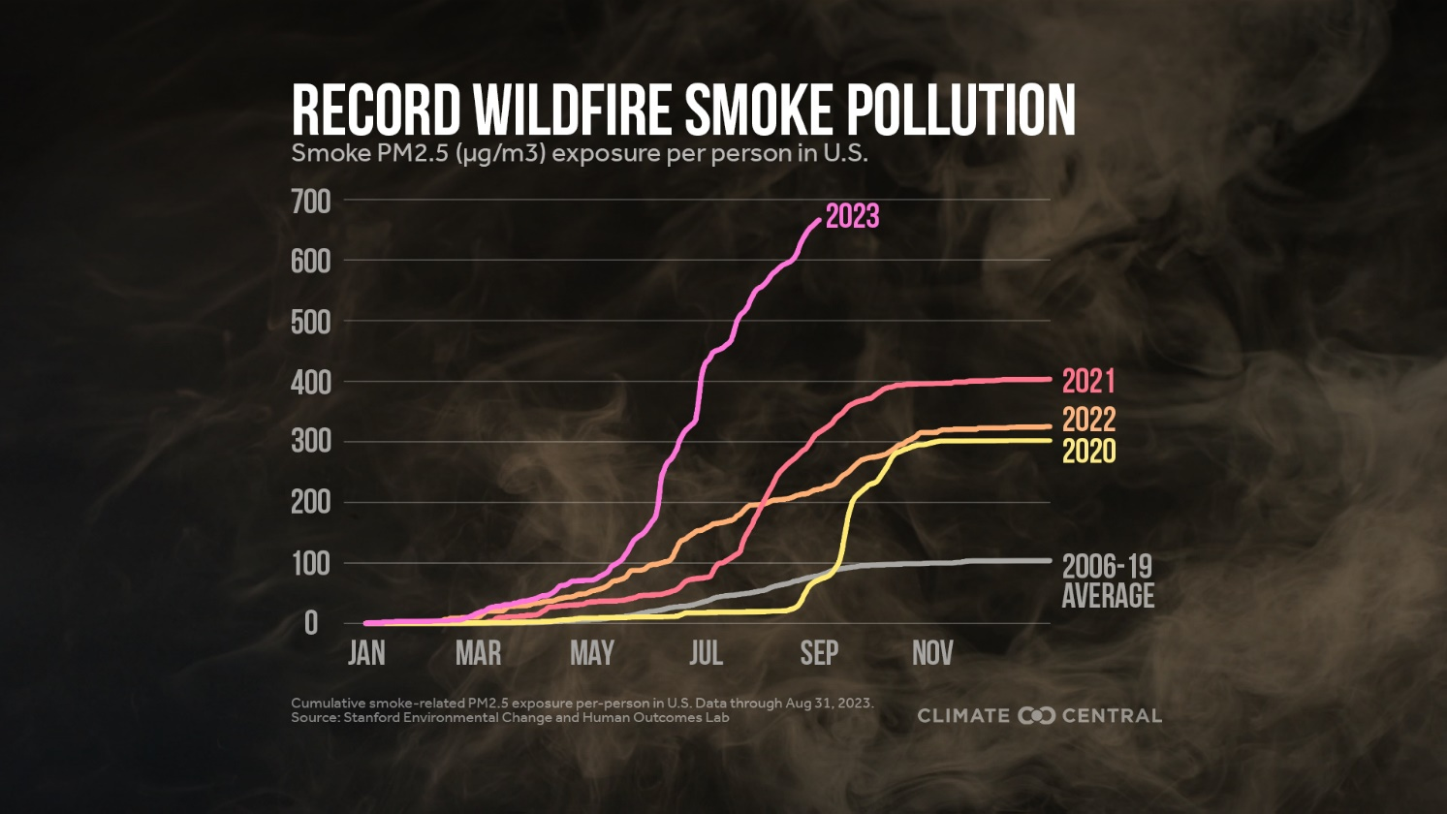
Air Quality Tends
Did You Know?
Fine particle pollution from wildfire smoke is a nationwide health concern. Studies suggest that smoke exposure in the U.S. has increased 27-fold over the last decade. The average person in the U.S. has breathed in more harmful wildfire smoke in 2023 than in any year since 2006.¹
Climate Central - Wildfire Smoke: Nationwide Health Risk ¹

Slide 34
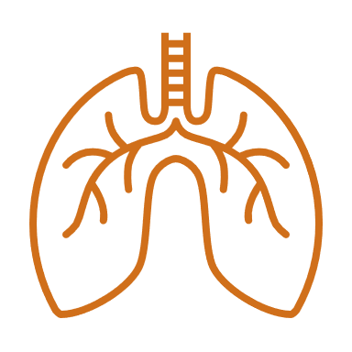
Short-Term Health Effects of Particulate Matter
Eye and respiratory tract irritation
Reduced lung function
Pulmonary inflammation
Bronchitis
Exacerbation of asthma and other lung diseases
Exacerbation of cardiovascular diseases, such as heart failure, and even premature death
AirNow: Wildfire Smoke – A Guide for Public Health Officials

Slide 35
Long-Term Health Effects of Particulate Matter
There is only limited evidence about the potential health impacts due to cumulative exposures from repeated, multi-day wildfire smoke exposures or multiple, consecutive fire seasons
AirNow: Wildfire Smoke – A Guide for Public Health Officials

Slide 36
Targeted Universalism
Sets universal goals for the general population that are accomplished through targeted approaches based on the needs of different groups.
Community Commons: Targeted Universalism

Slide 37
5 Steps Towards Targeted Universalism
2
5
1
4
3
Assess the general population performance relative to the universal goal
Establish a universal goal based upon a broadly shared recognition of a societal problem and collective aspirations
Assess and understand the structures and other factors that support or interfere each group from achieving the universal goal
Develop and implement targeted strategies for each group to reach the goal
Identify groups and places that are performing differently with respect to the goal and disaggregate them
Othering & Belonging Institute: Creating a Targeted Universalism Framework

Slide 38
Targeted Universalism: Step 1
1
Establish a universal goal based upon a broadly shared recognition of a societal problem and collective aspirations
Universal Goal: Minimize the community's exposure to harmful levels of particulate matter to mitigate negative health consequences
Othering & Belonging Institute: Creating a Targeted Universalism Framework

Slide 39
Targeted Universalism: Step 2
2
1
Assess the general population performance relative to the universal goal
Establish a universal goal based upon a broadly shared recognition of a societal problem and collective aspirations
Othering & Belonging Institute: Creating a Targeted Universalism Framework

Slide 40
Poll Everywhere Instructions
Polling Activity Instructions
Open a web browser on your computer or mobile device
Type “PollEv.com/naccho1” into your web browser
Enter your name as “Name, Your Organization”
Follow the polling instructions on the web platform*
*We will use the same poll link throughout the session. You do not need to enter your credentials more than once.

Slide 41
Targeted Universalism: Step 2
Assess the general population performance relative to the universal goal
Step 2
Notes:
Poll Title: Do not modify the notes in this section to avoid tampering with the Poll Everywhere activity. More info at polleverywhere.com/support How does the general population minimize their exposure to particulate matter? https://www.polleverywhere.com/free_text_polls/Dkmw2yBE3Tm4wFjz82YDH

Slide 42
Targeted Universalism: Step 3
2
1
3
Assess the general population performance relative to the universal goal
Establish a universal goal based upon a broadly shared recognition of a societal problem and collective aspirations
Identify groups and places that are performing differently with respect to the goal and disaggregate them
Risk: often evaluated in terms of how likely they are to occur (probability) and the damages that would result if they did happen (consequences)
Othering & Belonging Institute: Creating a Targeted Universalism Framework

Slide 43
Targeted Universalism: Step 3
Identify groups and places that are performing differently with respect to the goal and disaggregate them
Step 3
Notes:
Poll Title: Do not modify the notes in this section to avoid tampering with the Poll Everywhere activity. More info at polleverywhere.com/support Who is most likely to be exposed to poor air quality? https://www.polleverywhere.com/free_text_polls/UvQEeTnMV0yVxirkyS3go

Slide 44
Targeted Universalism: Step 3
Identify groups and places that are performing differently with respect to the goal and disaggregate them
Step 3
Notes:
Poll Title: Do not modify the notes in this section to avoid tampering with the Poll Everywhere activity. More info at polleverywhere.com/support Who in your community would be most likely to experience negative health effects from poor air quality? https://www.polleverywhere.com/free_text_polls/yDxBQoFSjzsD6xmqqZVUN

Slide 45
Targeted Universalism: Step 4
2
1
4
3
Assess the general population performance relative to the universal goal
Establish a universal goal based upon a broadly shared recognition of a societal problem and collective aspirations
Assess and understand the structures and other factors that support or interfere each group from achieving the universal goal
Identify groups and places that are performing differently with respect to the goal and disaggregate them
Othering & Belonging Institute: Creating a Targeted Universalism Framework

Slide 46
Targeted Universalism: Step 4
Assess and
understand the structures and other factors that support or interfere each group from achieving the universal goal
Step 4
Notes:
Poll Title: Do not modify the notes in this section to avoid tampering with the Poll Everywhere activity. More info at polleverywhere.com/support How would you notify groups most at risk that air quality is unhealthily or hazardous? https://www.polleverywhere.com/free_text_polls/cV0BlnM35I5kWVWqV30IL

Slide 47
Targeted Universalism: Step 5
“How” is just as important as asking the "What" or the "Why"
2
5
1
4
3
Assess the general population performance relative to the universal goal
Establish a universal goal based upon a broadly shared recognition of a societal problem and collective aspirations
Assess and understand the structures and other factors that support or interfere each group from achieving the universal goal
Develop and implement targeted strategies for each group to reach the goal
Identify groups and places that are performing differently with respect to the goal and disaggregate them
Othering & Belonging Institute: Creating a Targeted Universalism Framework

Slide 48
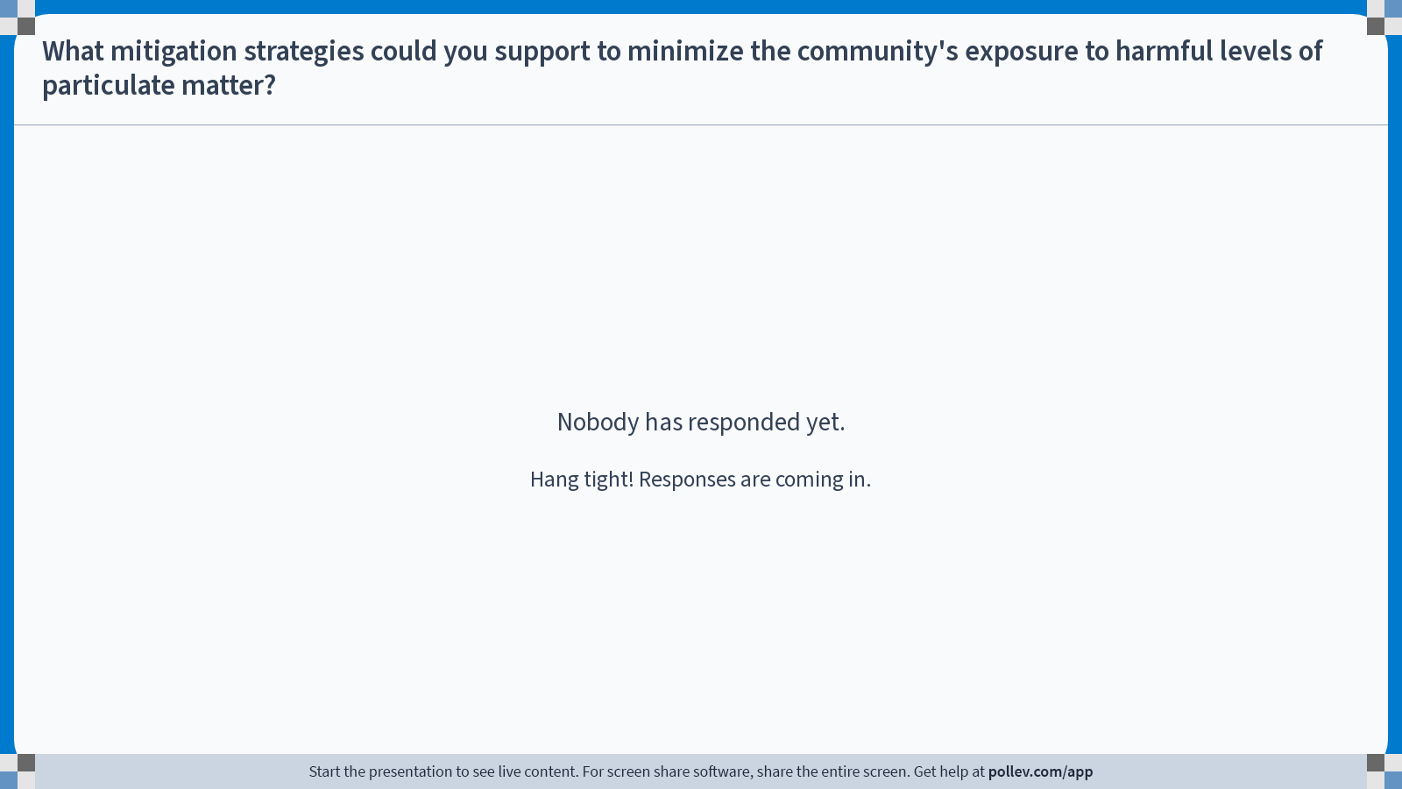
Targeted Universalism: Step 5
Develop and implement targeted strategies for each group to reach the goal
Step 5
Notes:
Poll Title: Do not modify the notes in this section to avoid tampering with the Poll Everywhere activity. More info at polleverywhere.com/support What mitigation strategies could you support to minimize harm? https://www.polleverywhere.com/free_text_polls/HRgnNK7IvbGZiPbM8lAXJ

Slide 49
Targeted Universalism
Sets universal goals for the general population that are accomplished through targeted approaches based on the needs of different groups.
Community Commons: Targeted Universalism

Slide 50
Air Quality Resources
Resource | Description
National Environmental Public Health Tracking Network | Maps Air Quality Data, including current and historical air quality, forecasted air quality, wildland fire predicted surface smoke, annual concentrations of toxins and average cancer risk
AirToxScreen Mapping Tool | Displays cancer risks, emissions data, and other AirToxScreen data by census track
PurpleAir | Used by community scientists to collect hyper-local air quality data and share it with the public
CDC Protect Yourself from Wildfire Smoke | Public health officials and others can use the resources these resources to help educate people about the risks of smoke exposure and actions they can take to protect their health
CDC Wildfire Smoke Health Officials & Professionals Resources | Public health officials and others can use the resources these resources to help educate people about the risks of smoke exposure and actions they can take to protect their health.
EPA Smoke-Ready Toolbox for Wildfires | Public health officials and others can use the resources these resources to help educate people about the risks of smoke exposure and actions they can take to protect their health.

Slide 51
Closing
Thank you so much for your engagement today!
What can you expect next?
We are asking you to...
Complete the Post-session feedback Survey
…and in return we will
Share a summary and playbook from today’s discussion
Notes:
LHD TTA Request Form
https://deloittesurvey.deloitte.com/Community/se/3FC11B262D627D13

Slide 52
Closing

