Slide 1
The National Identity for Public Health Departments
<?xml version="1.0"?><AllQuestions />
<?xml version="1.0"?><AllResponses />
<?xml version="1.0"?><Settings><answerBulletFormat>Numeric</answerBulletFormat><answerNowAutoInsert>No</answerNowAutoInsert><answerNowStyle>Explosion</answerNowStyle><answerNowText>Answer Now</answerNowText><chartColors>Use PowerPoint Color Scheme</chartColors><chartType>Horizontal</chartType><correctAnswerIndicator>Checkmark</correctAnswerIndicator><countdownAutoInsert>No</countdownAutoInsert><countdownSeconds>10</countdownSeconds><countdownSound>TicToc.wav</countdownSound><countdownStyle>Box</countdownStyle><gridAutoInsert>No</gridAutoInsert><gridFillStyle>Answered</gridFillStyle><gridFillColor>255,255,0</gridFillColor><gridOpacity>50%</gridOpacity><gridTextStyle>Keypad #</gridTextStyle><inputSource>Response Devices</inputSource><multipleResponseDivisor># of Responses</multipleResponseDivisor><participantsLeaderBoard>5</participantsLeaderBoard><percentageDecimalPlaces>0</percentageDecimalPlaces><responseCounterAutoInsert>No</responseCounterAutoInsert><responseCounterStyle>Oval</responseCounterStyle><responseCounterDisplayValue># of Votes Received</responseCounterDisplayValue><insertObjectUsingColor>Red</insertObjectUsingColor><showResults>Yes</showResults><teamColors>Use PowerPoint Color Scheme</teamColors><teamIdentificationType>None</teamIdentificationType><teamScoringType>Voting pads only</teamScoringType><teamScoringDecimalPlaces>1</teamScoringDecimalPlaces><teamIdentificationItem></teamIdentificationItem><teamsLeaderBoard>5</teamsLeaderBoard><teamName1></teamName1><teamName2></teamName2><teamName3></teamName3><teamName4></teamName4><teamName5></teamName5><teamName6></teamName6><teamName7></teamName7><teamName8></teamName8><teamName9></teamName9><teamName10></teamName10><showControlBar>All Slides</showControlBar><defaultCorrectPointValue>0</defaultCorrectPointValue><defaultIncorrectPointValue>0</defaultIncorrectPointValue><chartColor1>187,224,227</chartColor1><chartColor2>51,51,153</chartColor2><chartColor3>0,153,153</chartColor3><chartColor4>153,204,0</chartColor4><chartColor5>128,128,128</chartColor5><chartColor6>0,0,0</chartColor6><chartColor7>0,102,204</chartColor7><chartColor8>204,204,255</chartColor8><chartColor9>255,0,0</chartColor9><chartColor10>255,255,0</chartColor10><teamColor1>187,224,227</teamColor1><teamColor2>51,51,153</teamColor2><teamColor3>0,153,153</teamColor3><teamColor4>153,204,0</teamColor4><teamColor5>128,128,128</teamColor5><teamColor6>0,0,0</teamColor6><teamColor7>0,102,204</teamColor7><teamColor8>204,204,255</teamColor8><teamColor9>255,0,0</teamColor9><teamColor10>255,255,0</teamColor10><displayAnswerImagesDuringVote>Yes</displayAnswerImagesDuringVote><displayAnswerImagesWithResponses>Yes</displayAnswerImagesWithResponses><displayAnswerTextDuringVote>Yes</displayAnswerTextDuringVote><displayAnswerTextWithResponses>Yes</displayAnswerTextWithResponses><questionSlideID></questionSlideID><controlBarState>Expanded</controlBarState><isGridColorKnownColor>True</isGridColorKnownColor><gridColorName>Yellow</gridColorName></Settings>
<?xml version="1.0"?><AllAnswers />

Slide 2
Recognize these?
For decades, these agencies and non-profit organizations have used consistent visual symbols to build public awareness and make their work and personnel more visible.
What is the equivalent for health departments and public health?

Slide 3
Visibility and Recognition
Every day, public health department staff go about their duties in a way that is invisible to the communities where they work.
Public health departments should be visible and understood by policy makers, community partners, potential funders, and the public.
Adopting a consistent logo is one important way to achieve this goal.

Slide 4
Launched in 2006, the Public Health logo offers health departments a common visual symbol and message that helps them become universally recognized and understood.

Slide 5
The National Identity for Public Health Departments
Provides a national symbol that will increase visibility of public health departments.
Broadens understanding of public health departments and how their work benefits individuals, families, and the community-at-large.
Saves health departments the expense of developing their own symbol and message.

Slide 6
The National Identity for Public Health Departments
SYMBOL: The three pointed shield and stylized plus are images associated with health, protection, and growth.
COLORS: Blue, white, and khaki are U.S. Public Health Service colors. They are neutral and can work in a variety of settings.
WORDS: Prevent. Promote. Protect. is a simple, elegant statement about what public health does and achieves.
FONT: The size and position of the words are designed to attain balance with the logo graphics.
Four Components of a Logo

Slide 7
Using the Logo
The Public Health logo lets policymakers, community partners, and the public know their health department is on the job. It also lets health departments show pride in the people and power of public health.
Use of the logo is voluntary, but encouraged
Can be customized to add the health department name
Should not be rearranged, altered, or changed by adding or deleting elements, changing font type, size, or color
Can be used alone or in conjunction with existing health department logos
For more information: www.naccho.org/advocacy/phlogo

Slide 8
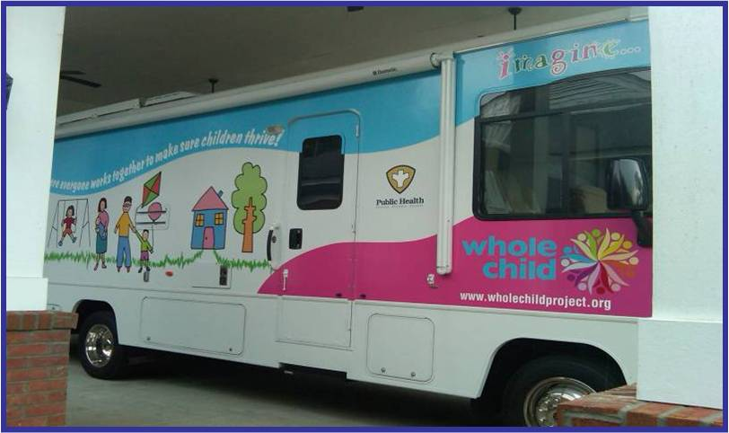
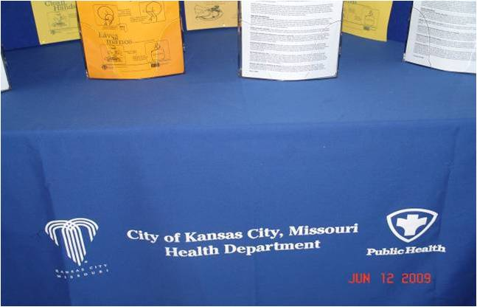
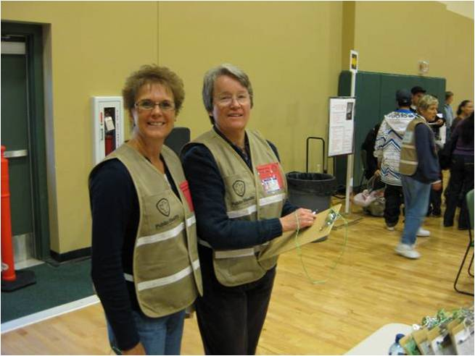
“Sometimes, people talk about public health being invisible. Well, if you don’t have a symbol or a sign or you don’t use it, then you shouldn’t be surprised if the public doesn’t remember you… We use a uniform with the public health logo on the back and it’s been amazing. Our inspectors are more respected and their interactions are more professional. The public respects that uniform presence.” Rex Archer, Kansas City Health Department, MO

Slide 9
“The logo is out there to put us on par with police and fire in terms of recognition, so when elected officials are at the table deciding how the money gets split up, they understand who public health is. We’re visible and we’re there responding.
We’re there to protect you and your families and our work is important. Hopefully, as we move on down the road, public health will no longer be the greatest story never told.”
Terry Allan, Cuyahoga County Health Department, OH

Slide 10
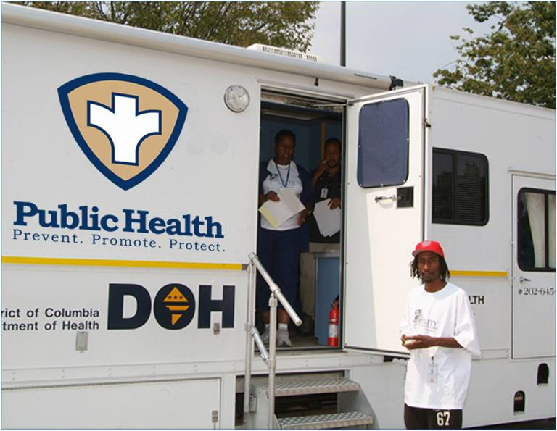
“What surprised me is the pride the people in my department have taken in having a symbol. They’re proud of their work. They‘re proud of public health, and they’ve embraced this symbol as a way to give them an identity in the community.” Lillian Shirley, Multnomah County Health Department, OR
When the logo first came out, I put it in my email signature line. It’s on our stationary. We put it on the clothing our staff wears. It’s something that brings us all together and provides a real continuity.
Kim Barnhill, Jefferson and Madison County Health Departments, FL

Slide 11
If used consistently and over time, this logo will raise awareness of the value of governmental public health, increase the visibility of your health department, and reassure people in the community that their health department is working to protect their health and safety.

